Slide 1
Behaviour at st cath’s

Slide 2




OUR RULES:
Show Love
Seek Truth
Be Ready
Stay Safe

Slide 3

BEHAVIOUR IS COMMUNICATION.
NEGATIVE BEHAVIOUR IS COMMUNICATION OF AN UNMET NEED
What are the children trying to tell us through their behaviour?

Slide 4
I’m trying to tell you about me
No one believes in me.
My home life is tough.
I’m tired.
I’m worried about the holidays.
I’m not feeling well.
My parents keep arguing and I’m scared.
I’m bored.
I’m hungry.
I want the other kids to like me.
I feel stupid.
I’ve heard my parents talking about money.
I feel insecure.
……

Slide 5
I’m trying to tell you about mY
Environment
It’s too busy.
It’s too loud.
It’s too hot/cold.
Other people keep annoying me.
I’m distracted by what’s going on outside.
I can’t see the board.
There’s a draft annoying me.
……

Slide 6
I’m trying to tell you about you
You aren’t fair/consistent.
Your lessons bore me.
I know you don’t like me.
You haven’t earned my respect.
You haven’t bothered to build a relationship with me.
You are grumpy and taking it out on me.
You act like you don’t want to be here.
You haven’t given me the tools I need to support my learning.
You haven’t bothered to set up/use my behaviour chart/reward system.
You make me feel small/belittled/
humiliated/scared.
Your behaviour management is rubbish!

Slide 7
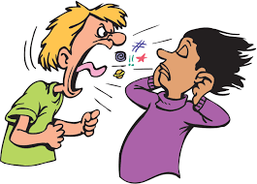

1. Visible consistency,
Relentless routines…
Meeting & Greeting.
‘Teacher’ stands at classroom door ‘Good morning xxx’
with a handshake and eye contact.
SLT out at beginning and end of the day.
2. Mindful Manners.
Expected that children will open doors, walk down the corridor
Quietly, say please and thank you, greet adults appropriately.
3. Quiet Lining.

Slide 8




2. First attention for best conduct
No more cloud!
Mrs Taylor
What do you think when you see this?
Everyone else
Miss Kane
Miss Stanton

Slide 9
FIRST ATTENTION FOR BEST CONDUCT
PIP & RIP
Praise in Public, Reprimand in Private.
Recognise pupils who are demonstrating ‘Expected Behaviour’. Reward those who are going ‘Over and Above’.

Slide 10
Rewards
No rewards for Expected Behaviour.
If we constantly reward minimum standards, children will strive for minimum standards.
Over and Above
If we reward for going Over and Above, then there is no limit to their excellent behaviour.
Examples – Someone who frequently tidies up other people’s belongings without being asked.
Postcard home. No expectation of everyone getting it or of a certain frequency.
What about those who may ‘never’ be Exceptional?
Headteacher’s Awards for Home Learning.

Slide 11
Recognition boards
Every class has a Recognition Board. At the top is one behaviour that we want to focus on – could be social or learning
- Even children who have received private sanctions can demonstrate
positive behaviours
- Names are never removed
- Learners can nominate names
It’s not a competition but everyone helping each other
Refreshed depending on the context
We use the board to persistently ‘catch’ children demonstrating
positive behaviours
RECOGNITION BOARD
Positivity

Slide 12



Slide 13
3 types of behaviour
Constant low-level, disruption by lots of children.
Solution = We have consistently high behaviour expectations
2. Generally good behaviour, with a small group of children ‘pushing it’.
Solution = We listen to the pupils and find out why. Some pupils follow rules, others follow people
3. A few pupils exhibiting extremely challenging behaviour (SEND)
Solution = Individual support plans

Slide 14
Stepped sanctions – low level behaviour
 | Steps | Actions
1 | REMINDER | Child reminded of school rules and made aware of poor behavioural choices.
2 | CAUTION | Clear verbal caution.
3 | MICROSCRIPT/ LAST CHANCE | Microscript used. 30-second intervention.

Slide 15
4 | TIME-OUT | Time for the child to reflect.
5 | SELF-REFLECTION | Work completed and Restorative Justice sheets completed.

Slide 16
6 | REPAIR & RESTORE | Informal meeting held as soon as possible, using prompts. If the matter needs to go to SLT, the adult accompanies the child to SLT at an appropriate time, with the completed sheets.

Slide 17
Consequences/
Restorative follow up
We believe in Restorative Justice.
The consequence needs to be related to the behaviour breach.
Natural Consequences
E.g. You make a mess, you clear it up.
If you can’t follow the rules, you get sent off/don’t get to play (we do not ban the whole class because a few children don’t follow rules).
A pupil hurts the feelings of another child. They have to do an apology card/letter and then play a game with them to make it up to them.
If they talk or are line when lining up, they have to walk with a teacher.
Talking excessively when they should be working, they have to move and work independently.
Disrupts the learning of others, doesn’t get to take part in ‘Golden Time’.
If work isn’t completed during lesson time, it must be completed at break/lunch.

Slide 18
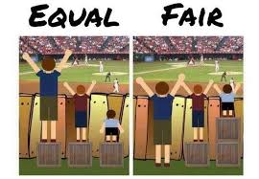
Pupils with additional needs
We are an inclusive school. We celebrate the unique gifts and talents of all our pupils and support every child to achieve human flourishing.
FAIR NOT EQUAL
Support they receive may not be visible to all.

Slide 19
exclusions
Single serious breach of the school’s behaviour policy.
Persistent breaches of the school’s behaviour policy.
Head teacher’s decision.

Slide 20
Language we use
We never ‘shout’.
We don’t have ‘naughty’ or ‘bad’ children.
We forgive and move on.

Slide 21
KEY Principles
Fair
Consistent
Transparent
Positive
We believe that every mistake is a learning opportunity and an opportunity to grow
United front

Slide 22
When will we contact you
Physical violence which we are aware of.
Context is key – swearing in EYFS v swearing in Year 6.
Serious or persistent issues.
Where a matter is unresolved.

Slide 23
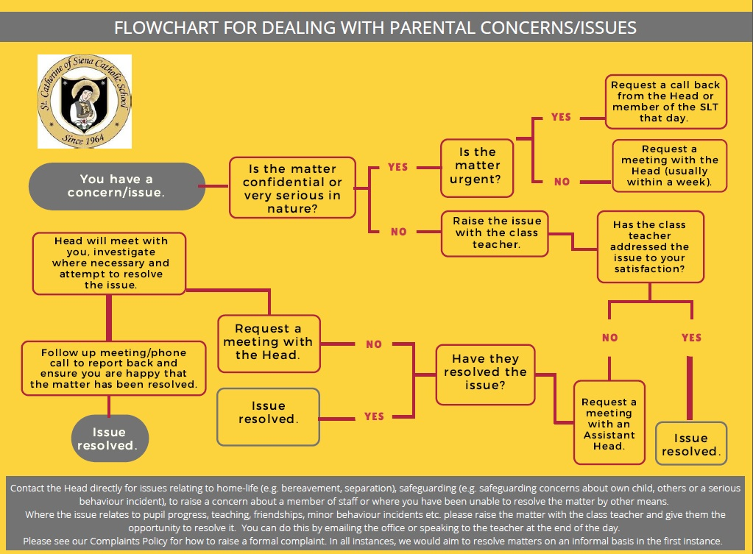

Slide 24
Myth buster
Xxx did the same thing last week and didn’t get in trouble.
Nothing is being done about xxxx pupil.
My child isn’t being treated fairly.
This is the xxx time this has happened. It has been going on for months.
They are being bullied by xxx.
Xxxx is dangerous/violent.

