Slide 1
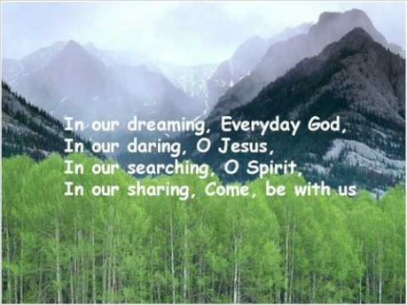

Slide 2


Collective Worship
Cooperation

Slide 3
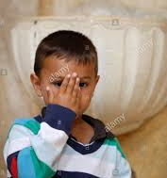
Let us join together, making the sign of the cross as a sign that we about to talk to God.
WE GATHER
In the name of the Father, and of the Son, and of the Holy Spirit, Amen.

Slide 4

WE LISTEN TO THE WORD OF GOD
1 Corinthians 12:12-31 ICB

Slide 5
The Treasure Chest

Slide 6
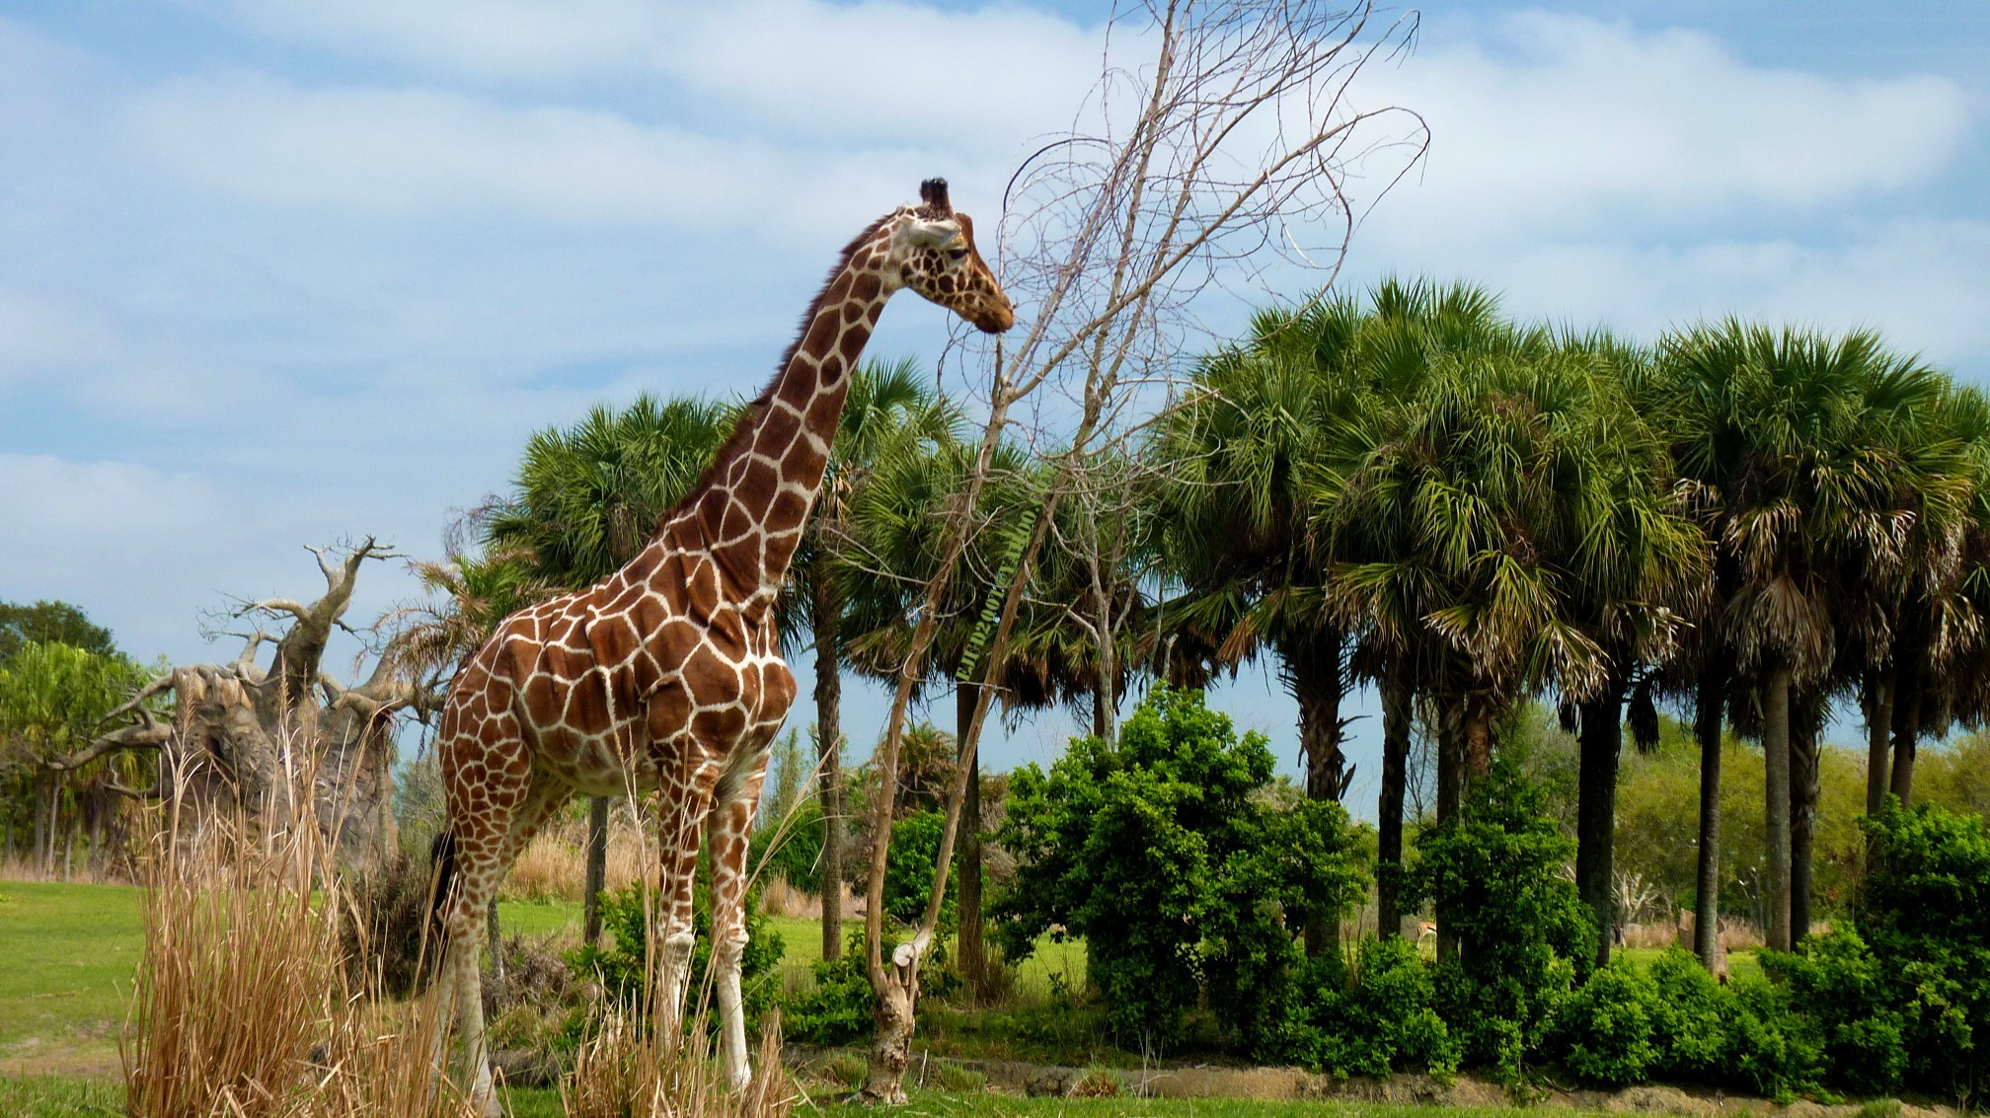

Slide 7
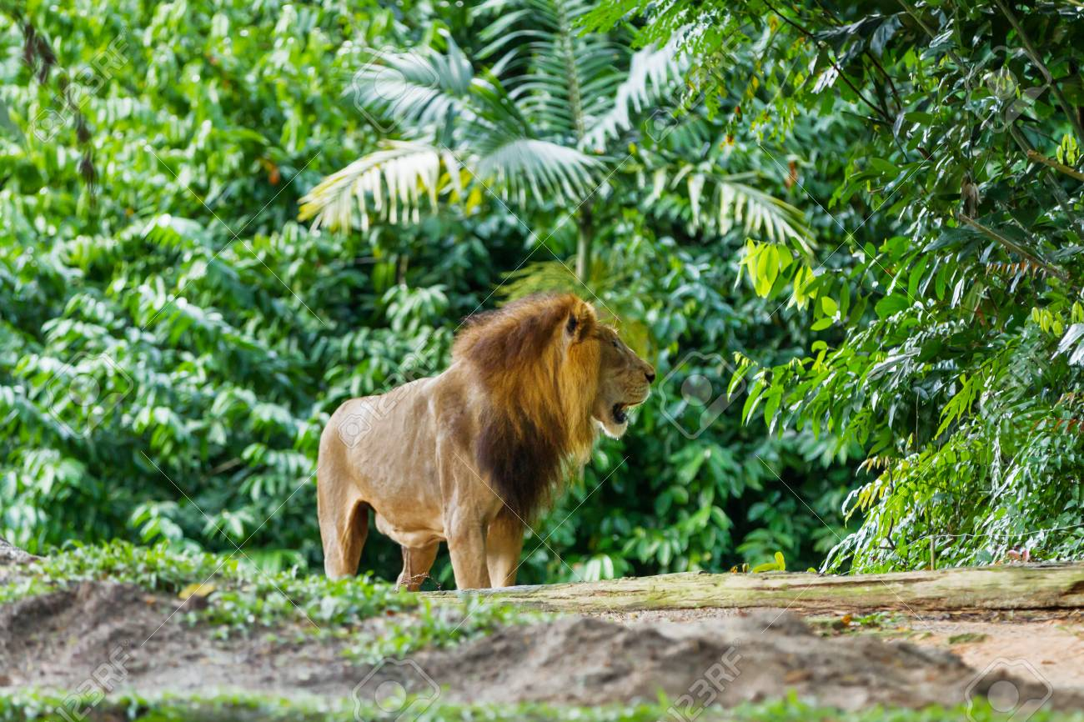

Slide 8
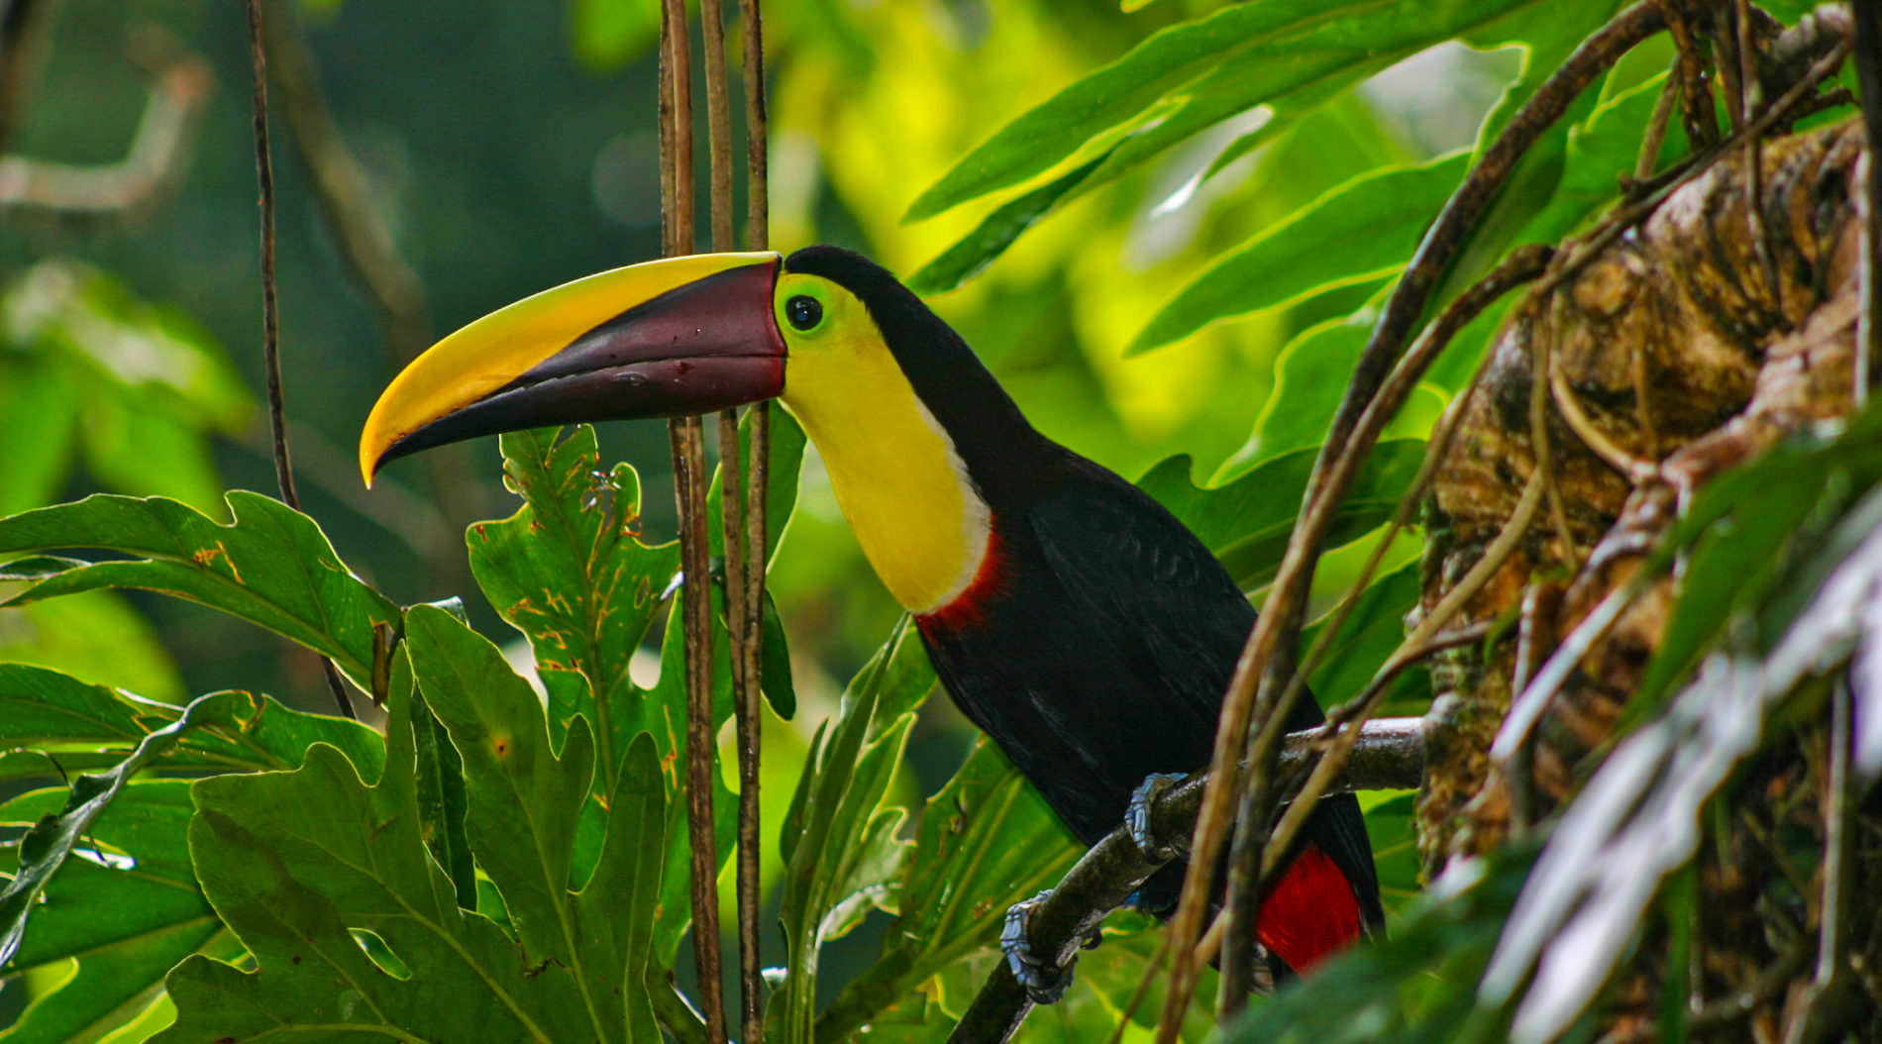

Slide 9
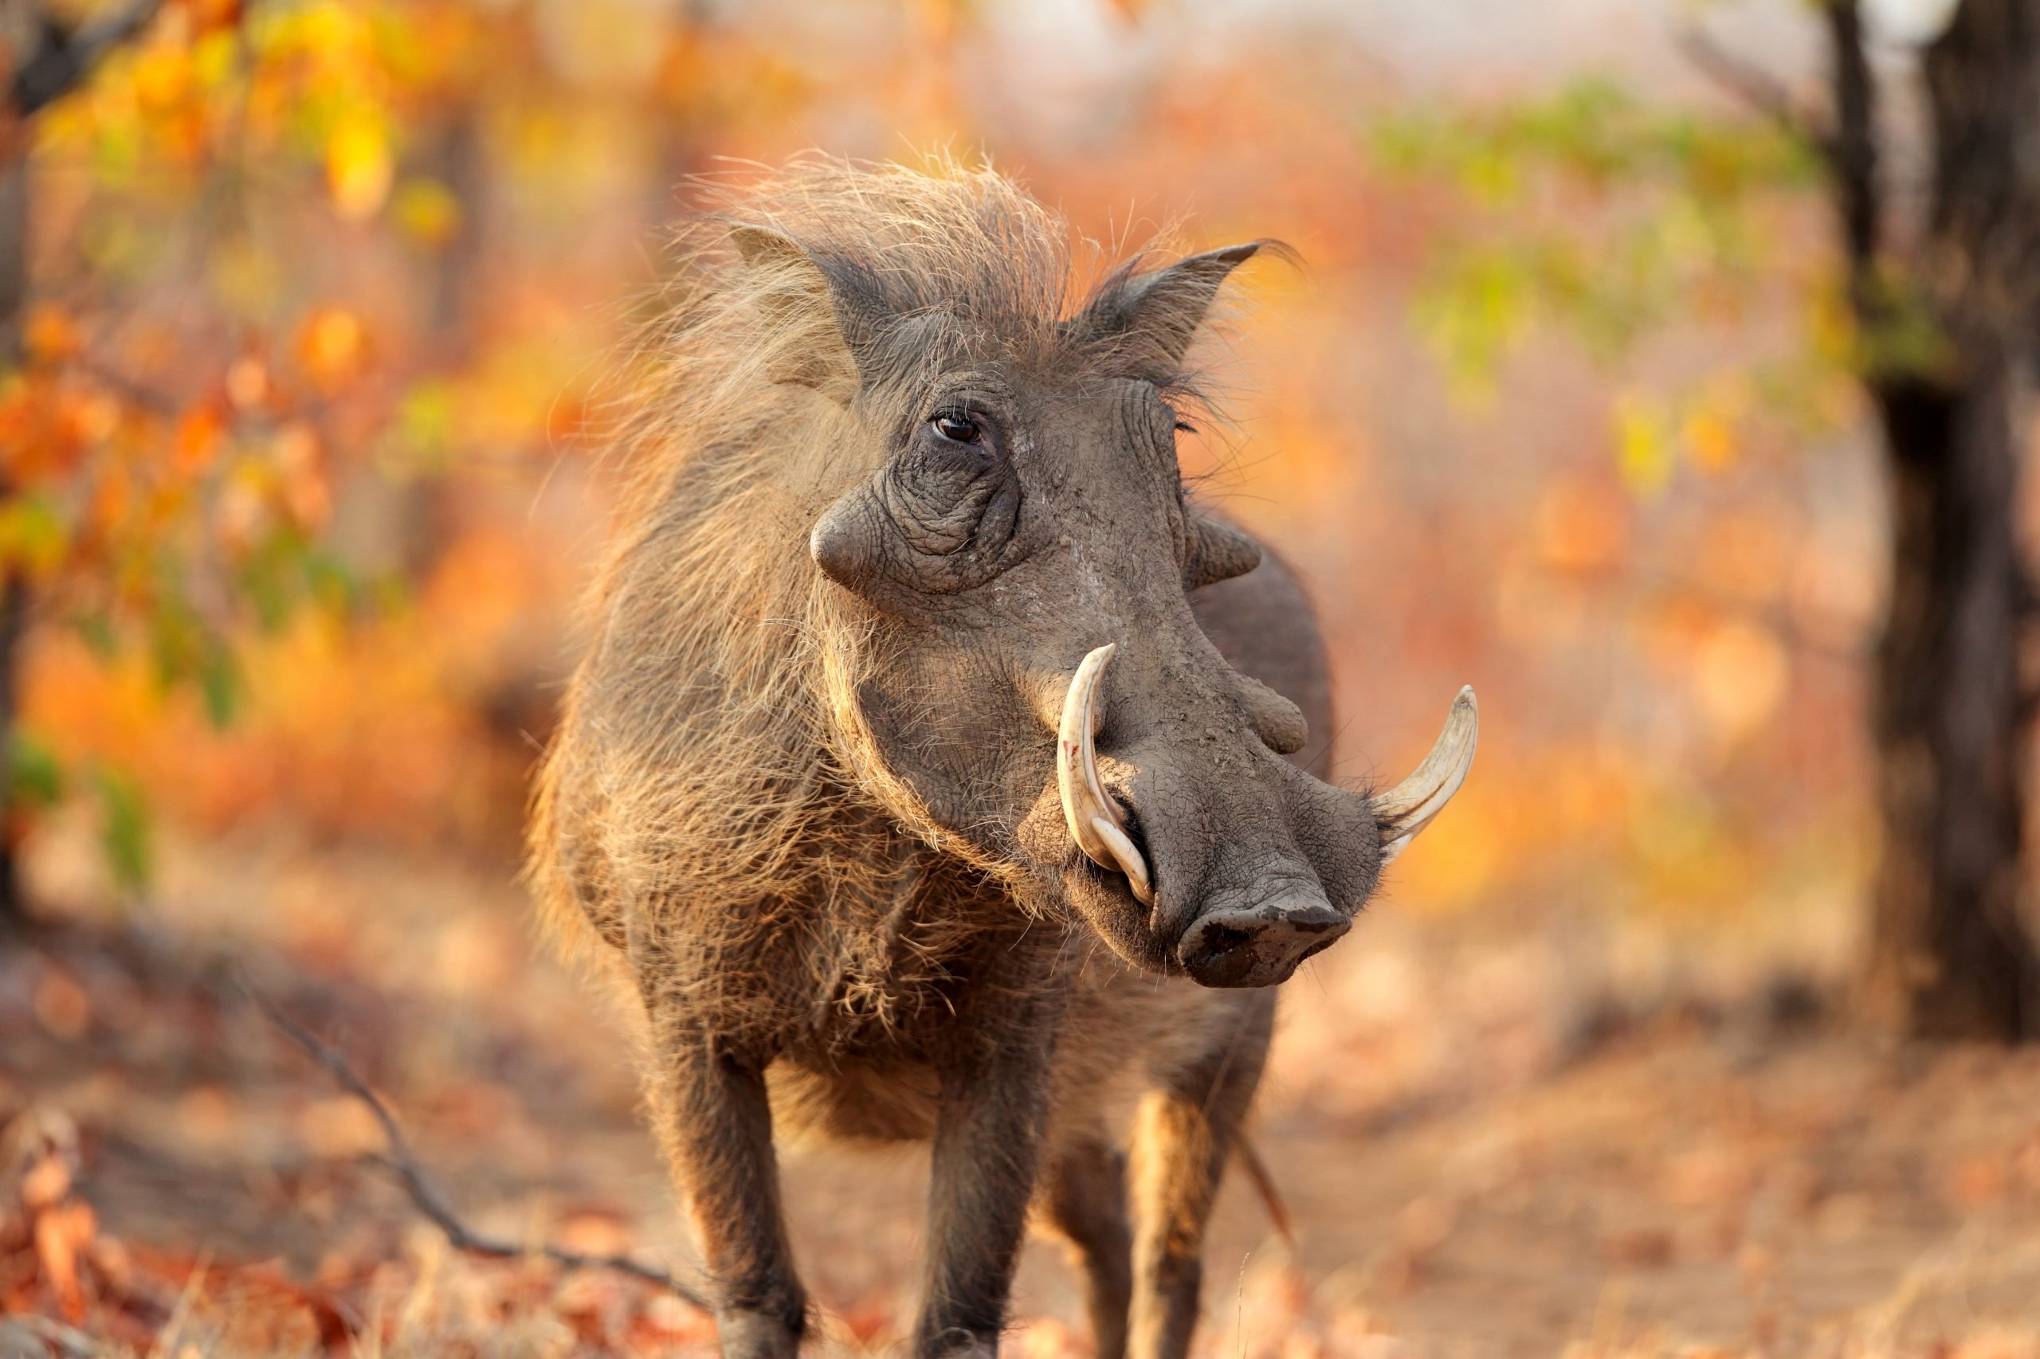

Slide 10
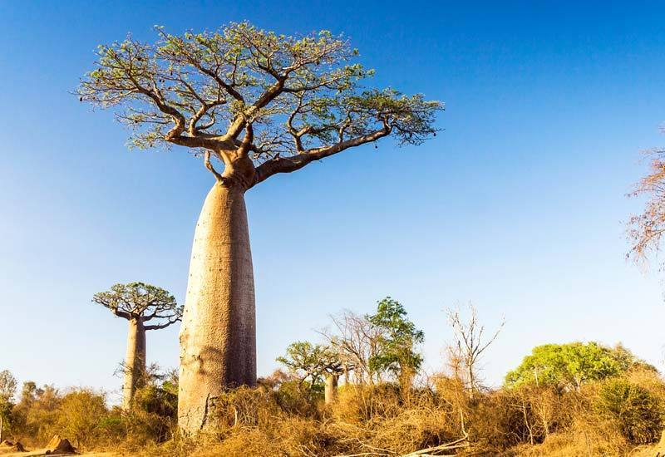

Slide 11
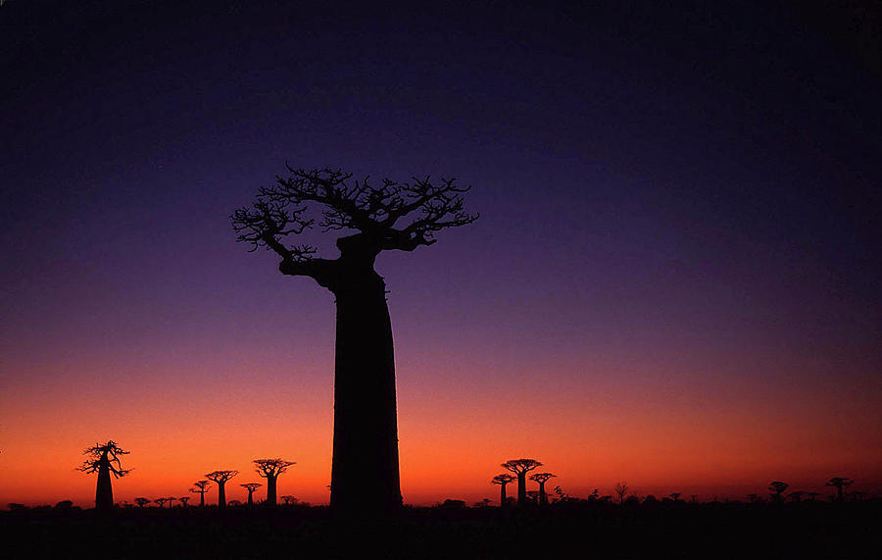

Slide 12




Slide 13


Slide 14


Slide 15


Slide 17


Slide 18
GO FORTH
Think about how you can cooperate with others this week.
How could you combine your gifts and talents with those of others, to achieve something that none of you could do on your own?

Slide 19
Dear Lord,
You made each one of us unique. You gave us each different talents. Help us to cooperate so that together we can achieve great things.
St Catherine of Siena and St Michael pray for us.
In the name of the Father, and of the Son, and of the Holy Spirit, Amen.
Let us say together:

Slide 20
Final Hymn
Join together in some ‘Whisper Singing.’ https://www.youtube.com/watch?v=jgnXHVsSXX0

