Slide 1
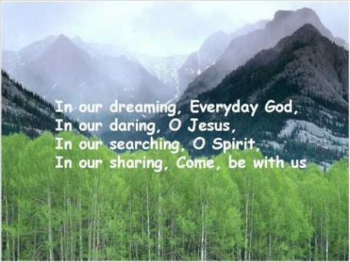

Slide 2


Collective Worship
Cooperation

Slide 3
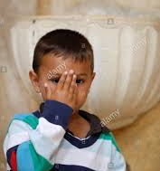
Let us join together, making the sign of the cross as a sign that we about to talk to God.
WE GATHER
In the name of the Father, and of the Son, and of the Holy Spirit, Amen.

Slide 4
We Listen
A Letter from St Paul to the Romans
12:6-8

Slide 5
We Respond
Think back to the story about the Treasure Chest. What do you think the treasure was that the animals discovered?
What do you have inside your own Treasure Chest? What gifts, talents and skills has God given you, which you could share with others?
Use pictures or words to fill the chest with the things that make you unique and special. Decorate it to make it look beautiful.

Slide 6
GO FORTH
Think about how you can cooperate with others this week.
How could you combine your gifts and talents with those of others, to achieve something that none of you could do on your own?

Slide 7
Dear Lord,
Please help us to recognise and value our own treasures. Let us work with those around us so that we bring out the best in each other and combine our talents to fulfil your purpose.
Amen
St Catherine of Siena and St Michael pray for us.
In the name of the Father, and of the Son, and of the Holy Spirit, Amen.
Let us say together:

Slide 8
Final Hymn
Join together in some ‘Whisper Singing.’ https://www.youtube.com/watch?v=jgnXHVsSXX0

