Slide 2
Collective Worship Examen

Slide 3
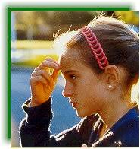
Let us join together, making the sign of the cross as a sign that we about to talk to God.
WE GATHER
In the name of the Father, and of the Son, and of the Holy Spirit, Amen.

Slide 4
WE LISTEN TO THE WORD OF GOD “When you call to me I will listen to you…when you seek me, you will find me… when you seek me with all of your heart, I will be there for you. Jeremiah 29: 11-14

Slide 5
Examen

Slide 6
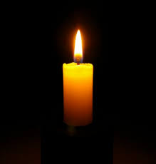

Slide 7
God, you are with us all day long, from the moment we wake up, until now. Help us to remember our day, so we can bring it to you.
Let us say together:

Slide 8
WE RESPOND
What good things happened this week?

Slide 9
Think about where God was present in your life this week.

Slide 10
What has stood out during this week? It might be something good or bad.

Slide 11
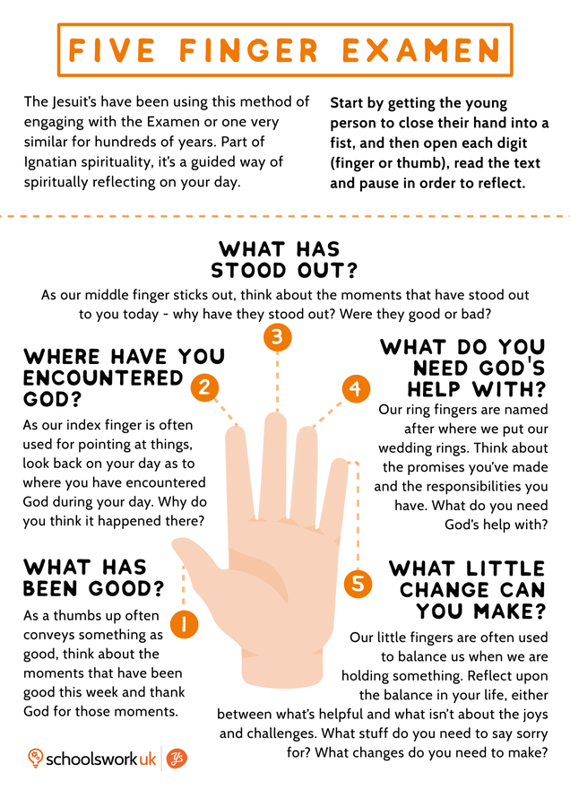
What do you need God’s help with?

Slide 12
What little change can you make? Do you need to say sorry to anyone, or to God for an mistakes you have made?

Slide 13
GO FORTH Think of one thing that you can do to set the world on fire. Throughout this week, when you look at your hand, remember that God is always with you. In the name of the Father, and of the Son, and of the Holy Spirit, Amen.

Slide 14
Final Hymn Join together in some ‘Whisper Singing’ of a new hymn. Lord We’ve Come to Worship https://www.youtube.com/watch?v=fyPaS2m4e5A

