Slide 1
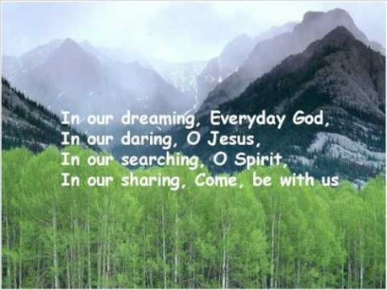

Slide 2


Collective Worship Examen

Slide 3
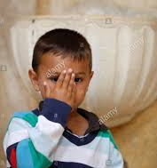
Let us join together, making the sign of the cross as a sign that we about to talk to God.
WE GATHER
In the name of the Father, and of the Son, and of the Holy Spirit, Amen.

Slide 4
WE LISTEN TO THE WORD OF GOD “The earth is the Lord’s, and all it contains, The world, and those who dwell in it. For He has founded it upon the seas And established it upon the rivers.” Psalm 24:1-2

Slide 5
Examen

Slide 6
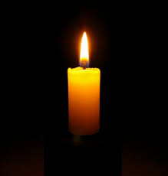

Slide 7
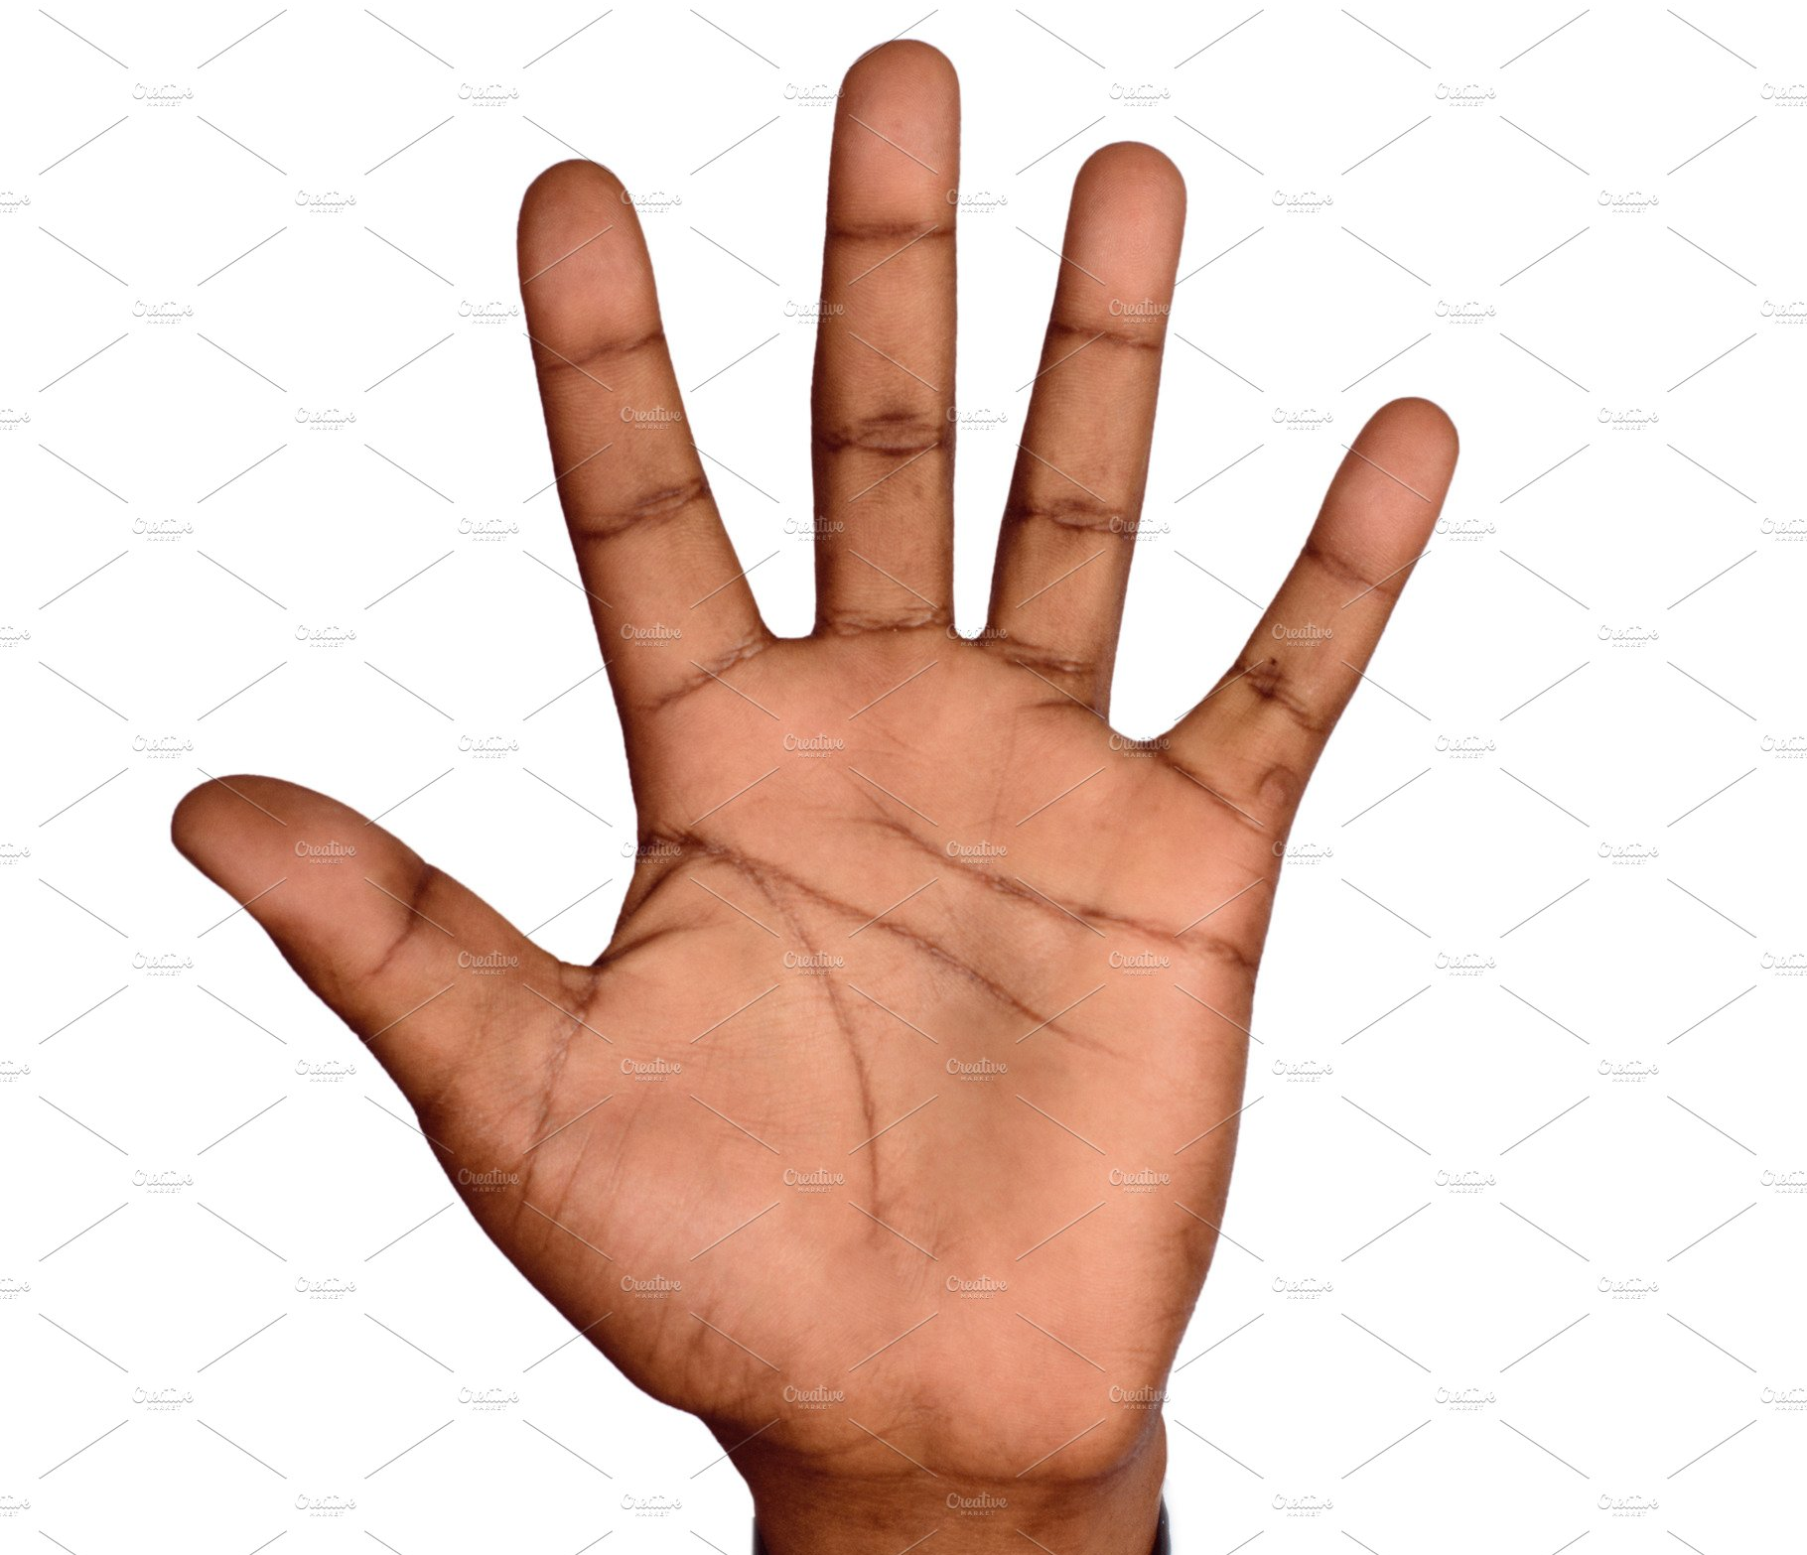
WE RESPOND
What good things happened this week?

Slide 8
Think about where God was present in your life this week.

Slide 9
What has stood out during this week? It might be something good or bad.

Slide 10
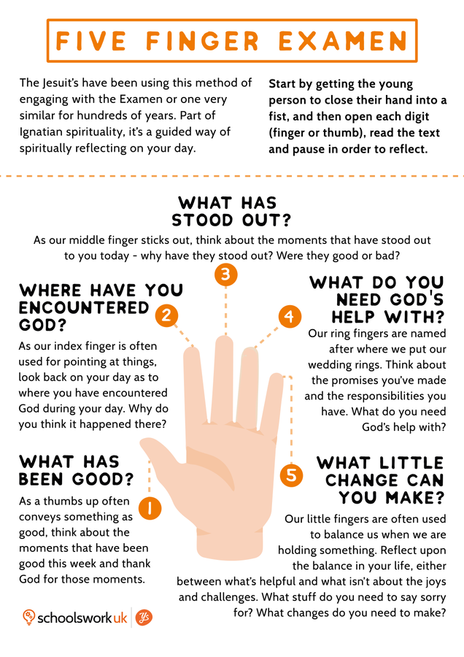
What do you need God’s help with?

Slide 11
What little change can you make?

Slide 12
Lord God, Everything good in the world came from you. You made the world and you made us with real love and care. Thank you for your world. Thank you that you are still in the world and with us in everything we do. Amen.
Let us say together:

Slide 13
GO FORTH Think of one thing that you can do to set the world on fire. Throughout this week, when you look at your hand, remember that God is always with you. In the name of the Father, and of the Son, and of the Holy Spirit, Amen.

Slide 14
Final Hymn Join together in some ‘Whisper Singing’ of a new hymn. Lord We’ve Come to Worship https://www.youtube.com/watch?v=fyPaS2m4e5A

