Slide 1
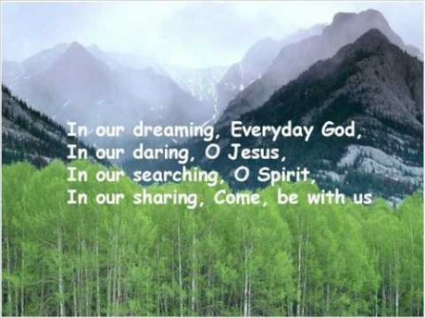

Slide 2

Collective Worship
Friendship

Slide 3
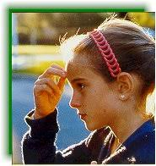
Let us join together, making the sign of the cross as a sign that we about to talk to God.
WE GATHER
In the name of the Father, and of the Son, and of the Holy Spirit, Amen.

Slide 4
What is friendship?
Trust laughter
Caring
Understanding
Fun
Supportive
Sincere

Slide 5
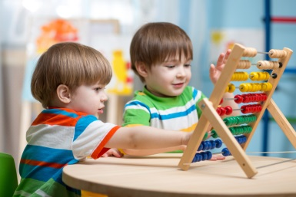

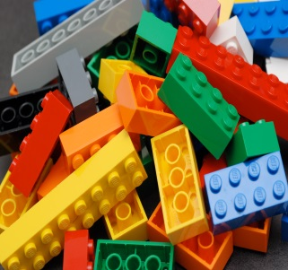
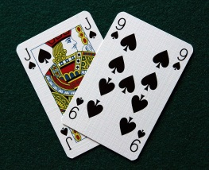

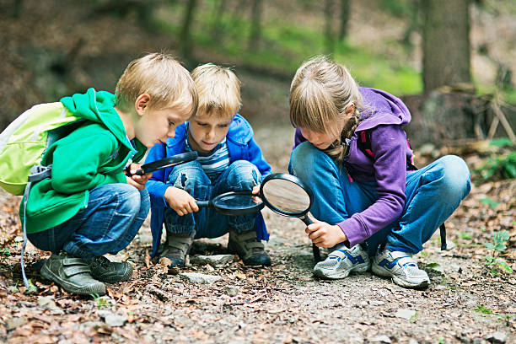

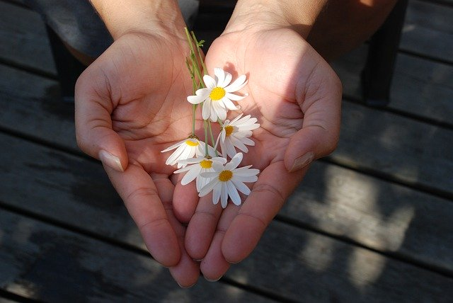
How do you show your friendship?

Slide 6
WE RESPOND
Close your eyes or focus on the candle. Make sure that you are comfortable. Think about those in your life who are your friends and ask God to guide you in being a good friend always.

Slide 7
WE LISTEN TO THE WORD OF GOD
Saul son’s Jonathan came to love him as much as he loved himself. Jonathan swore deep eternal friendship with David because of his deep affection for him”—
Samuel 18:1-3

Slide 8
MEDITATION
https://www.youtube.com/watch?v=Q2iQKO77xR8

Slide 9
As we close our Collective Worship, think about how you can be a best friend to those people in your lives.
How can you help yourself to respond positively to friendship?
What can you make to give your best friend or friends to show them you care today?

Slide 10
Let us join together in reading our prayer: (repeat after me).
Loving God,
Bless my life with the gift of friendship.
For those I have chosen to be my friends I am grateful.
Let our love and affection for each other grow as we grow.
Make me a good friend who is ready to forgive.
To you dear God our truest friend, we pray.
Amen.

Slide 11


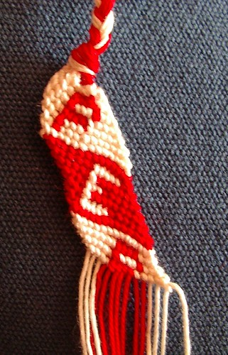

Watch/Think/Practise/Achieve https://www.youtube.com/watch?v=CNi02gxTI1M

