Slide 1
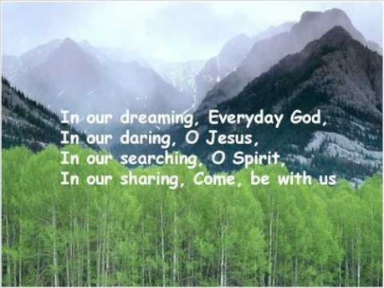

Slide 2


Collective Worship
Friendship

Slide 3
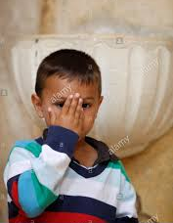
Let us join together, making the sign of the cross as a sign that we about to talk to God.
WE GATHER
In the name of the Father, and of the Son, and of the Holy Spirit, Amen.

Slide 4
WE LISTEN TO THE WORD OF GOD
‘My command is this: Love each other as I have loved you. Greater love has no one than this: to lay down one’s life for one’s friends…’
John 15:12-13

Slide 5
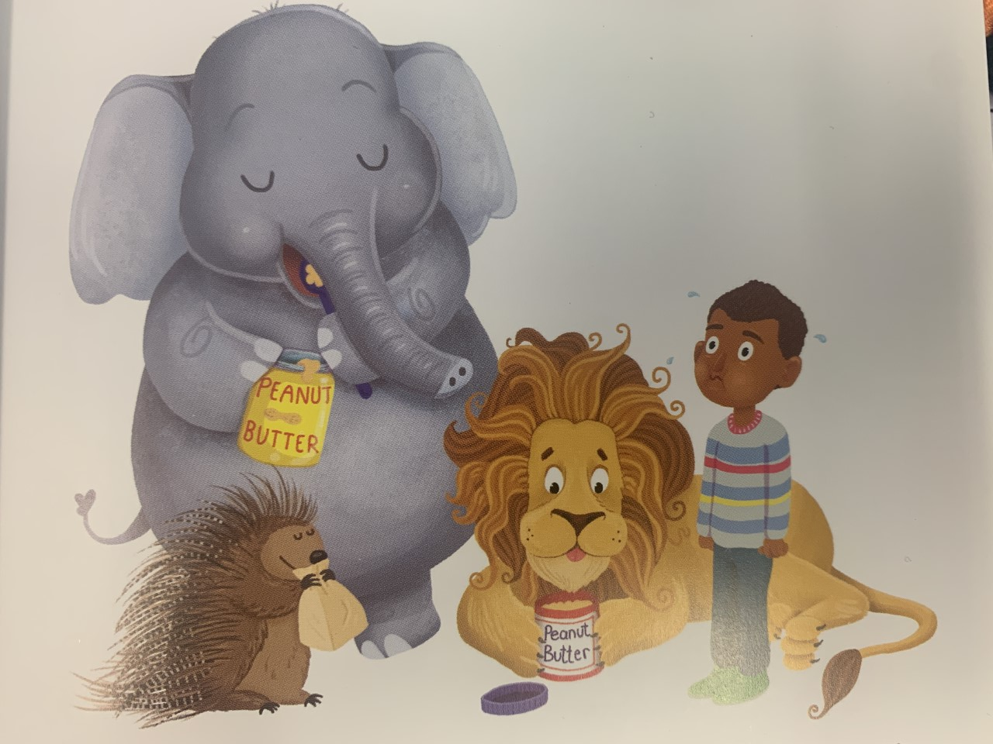
RESPOND
Even elephants hiccup.
https://vimeo.com/407747615

Slide 6
GO FORTH
Think of one thing that you can do to set the world on fire.
How can you be a good friend and show love to others even when it is hard?
Pick one person in your class, who you aren’t usually friends with, and show them a kindness this week.

Slide 7
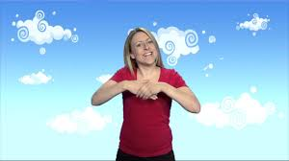
Learn how to sign ‘Friends’…
https://www.youtube.com/watch?v=qI6JJgd7lMo

Slide 8
Final Prayer
Let us pray together:
Lord,
When others are unkind or even mean, help me to remember Jesus and how He loved everyone, even those who hated Him. Then help me to show the same kind of love and kindness to others.
Amen.

Slide 9
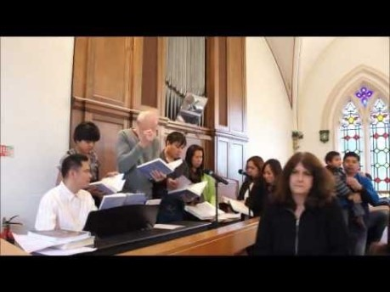
Final Hymn
Join together in some ‘Whisper Singing’ of ‘Bind us together Lord’.

