Slide 1
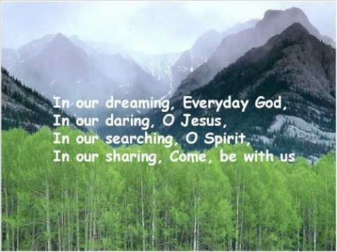

Slide 2


Collective Worship
Friendship

Slide 3
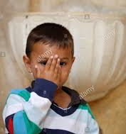
Let us join together, making the sign of the cross as a sign that we about to talk to God.
WE GATHER
In the name of the Father, and of the Son, and of the Holy Spirit, Amen.

Slide 4
WE LISTEN TO THE WORD OF GOD
‘I thank my God for you, each time I think of you.’
Philippians 1:3

Slide 5
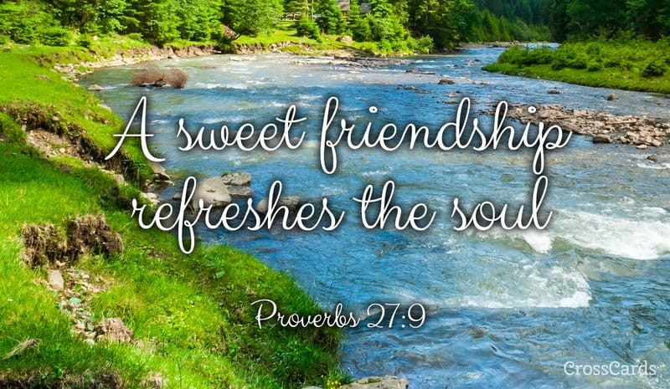

Slide 6
The refrain is:
I am able to love others because Jesus loves me.
Amen.
Let us pray together:

Slide 7
GO FORTH
Close your eyes. Tell God why you want to give thanks for this person…then whisper the person’s name.
In the name of the Father, and of the Son, and of the Holy Spirit, Amen.

Slide 8
Final Hymn
Join together in some ‘Whisper Singing’ of a new hymn.
'Jesus put this song into our hearts’ https://www.youtube.com/watch?v=rgKaXcpm4F8

