Slide 1
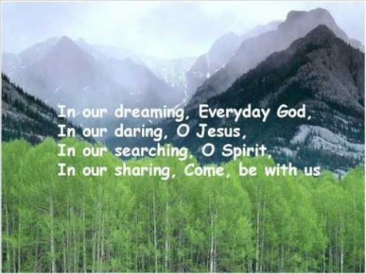

Slide 2


Collective Worship
Patience

Slide 3
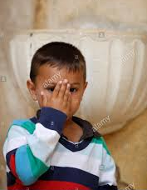
Let us join together, making the sign of the cross as a sign that we about to talk to God.
WE GATHER
In the name of the Father, and of the Son, and of the Holy Spirit, Amen.

Slide 4
WE LISTEN TO THE WORD OF GOD
‘Be completely humble and gentle; be patient, bearing with one another in love.’
Ephesians 4:2

Slide 5
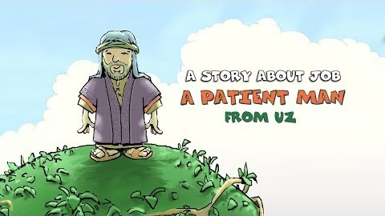
RESPOND
The Story of Job –
A Very Patient Man

Slide 6

Learn how to sign ‘Patience’…

Slide 7
GO FORTH
When do you find it hard to be patient? Is there anyone who makes you feel impatient? Perhaps a sibling, or someone in your class. Do you find it hard to wait for something you want?
Ask God to help you be more patient.

Slide 8

Final Prayer
Let us pray together:

Slide 9
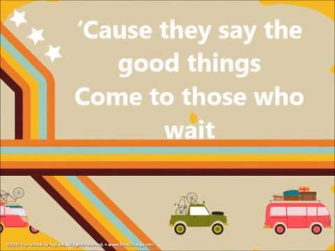
Final Song
Join together in some ‘Whisper Singing’.

