Slide 1
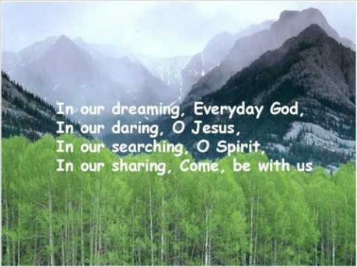

Slide 2


Collective Worship
Patience

Slide 3
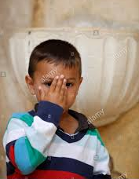
Let us join together, making the sign of the cross as a sign that we about to talk to God.
WE GATHER
In the name of the Father, and of the Son, and of the Holy Spirit, Amen.

Slide 4
WE LISTEN TO THE WORD OF GOD
“Be patient, therefore, brothers, until the coming of the Lord. See how the farmer waits for the precious fruit of the earth, being patient with it until it receives the early and the late rains. You too must be patient. Make your hearts firm, because the coming of the Lord is at hand.” [James 5:7]

Slide 5
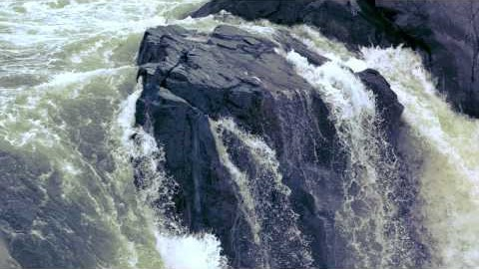
RESPOND
Mindful Colouring In
- Colour in the ‘Patience’ picture as you listen to this meditation.

Slide 6
Sign ‘Patience’ to your partner.

Slide 7
GO FORTH
Whenever you find yourself feeling impatient this week, stop and repeat to yourself, ‘I can be patient.’

Slide 8
Final Prayer
As we read the prayer to you, think about asking God for his help to be more patient.
When there is a pause, please reflect.

Slide 9
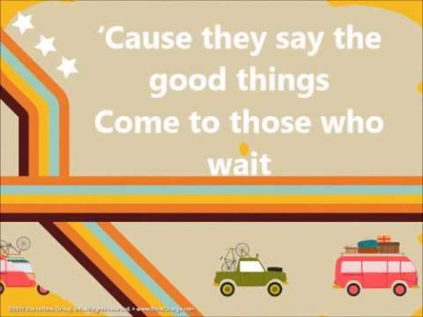
Final Song
Join together in some ‘Whisper Singing’.

