Slide 1
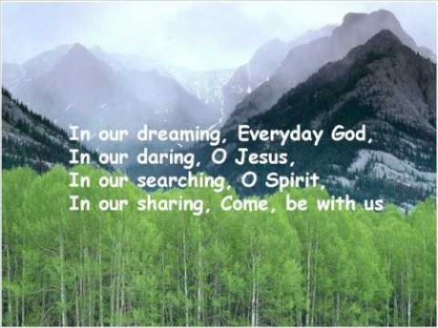

Slide 2


Collective Worship
Respect

Slide 3
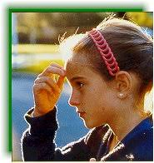
Let us join together, making the sign of the cross as a sign that we about to talk to God.
WE GATHER
In the name of the Father, and of the Son, and of the Holy Spirit, Amen.

Slide 4
WE LISTEN TO THE WORD OF GOD
“I was hungry and you fed me, thirsty and you gave me a drink...’
Matthew 25:35-40

Slide 5
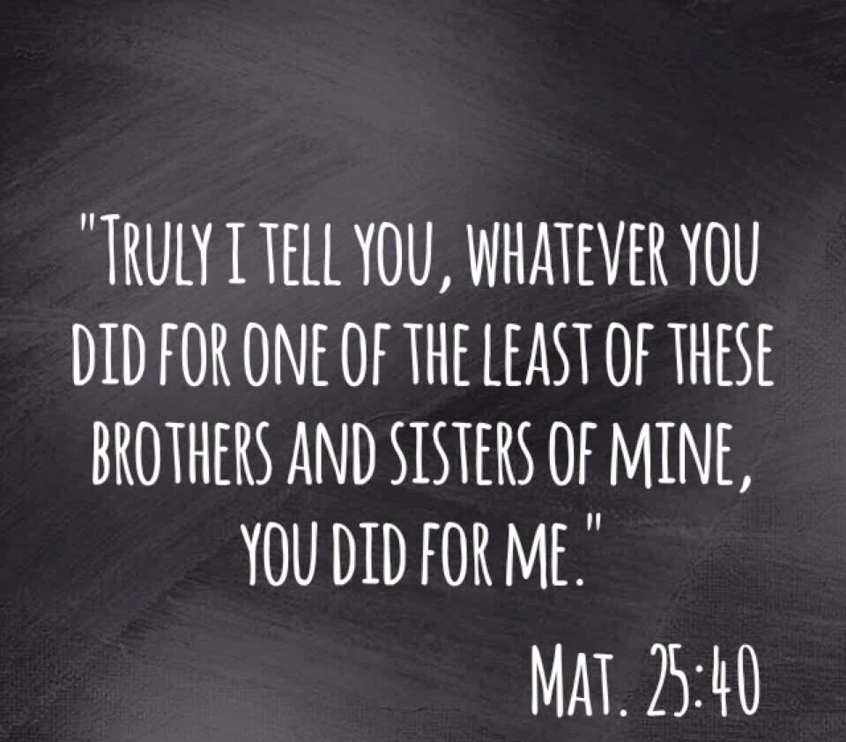

Slide 6
RESPOND
RESPECT – What does it mean to you?

Slide 7
GO FORTH
Think of one thing that you can do to set the world on fire.
Throughout this week, try to show respect to all members of your home and school community.

Slide 8
Final Prayer
Let us pray together:
Dear God,
Thank you that you value each one of us.
Please help us to treat others with respect.
Help us to embrace differences between us.
Help us to love others, even if they are very different from us.
Help us to see the value in each individual person.
Amen.

Slide 9
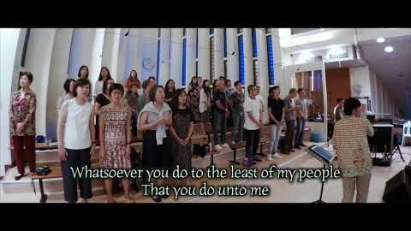
Final Hymn
Join together in some ‘Whisper Singing’ of ‘Whatsoever you do, to the least of my people’.

