Slide 1
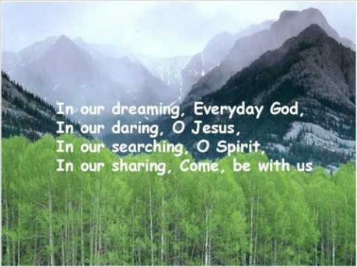

Slide 2

Collective Worship
Self-belief

Slide 3
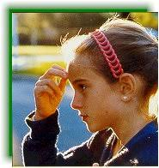
Let us join together, making the sign of the cross as a sign that we about to talk to God.
WE GATHER
In the name of the Father, and of the Son, and of the Holy Spirit, Amen.

Slide 4
What is self-belief?

Slide 5
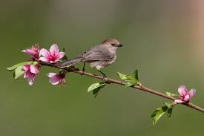

Slide 6
WE LISTEN TO THE WORD OF GOD
“I can do all things through Him who strengthens me.”
Philippians 4:13

Slide 7
WE RESPOND
Either close your eyes or focus on the candle. Make sure that you are comfortable.

Slide 8
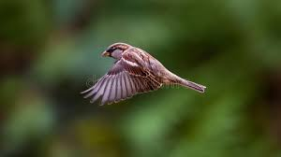
MEDITATION

Slide 9
As we close our Collective Worship, think about how you can use your belief in yourself to do great things.
How can you help your friends to be the best that they can be?
How can you support your classmates to get onto our Recognition Board?
Think of one thing that you can do to set the world on fire this week?

Slide 10
Let us join together in reading our prayer:
Here in our school,
Let us be peaceful at all times.
Let our rooms be full of happiness and respect for each other,
Let love be in our hearts,
With kindness and compassion for all.
Let us remember that in learning together,
We grow together and succeed together.
Amen

Slide 11
https://www.youtube.com/watch?v=pphYHt9gw4s
Follow link.

