Slide 1

Welcome

Slide 2


Be who God created you to be and you will set the world on fire.

Slide 3

Expectations:
To gain an understanding of the Year 1 national curriculum and the year ahead.
To know what is expected from your child in Year 1 and
ways you can support them at home.
Phonics screening test.
To answer any questions that you may have.
:

Slide 4
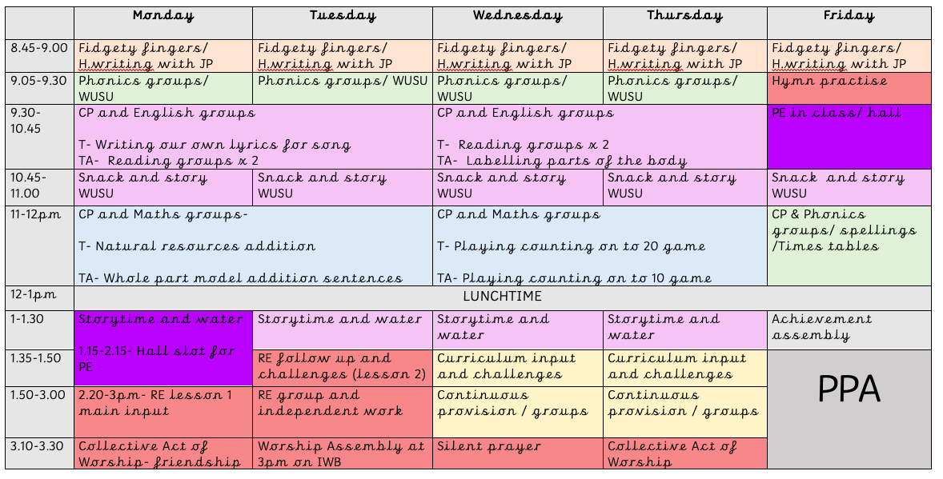
A typical week in Year 1…

Slide 5
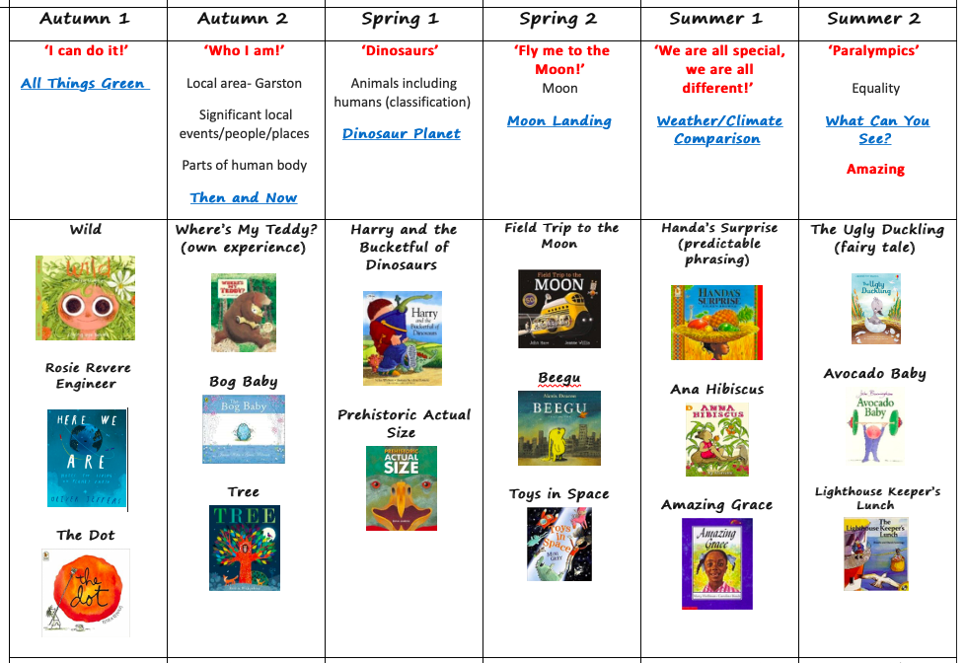
Text based curriculum…

Slide 6
We follow the National Curriculum 2014.
At the end of the year children will be given an overall best fit assessment against the expectations for their year group.
These will now be:
Working towards the expected National Year 1 level
Working at the expected National Year 1 level
Exceeding the expected National Year 1 Level

Slide 7
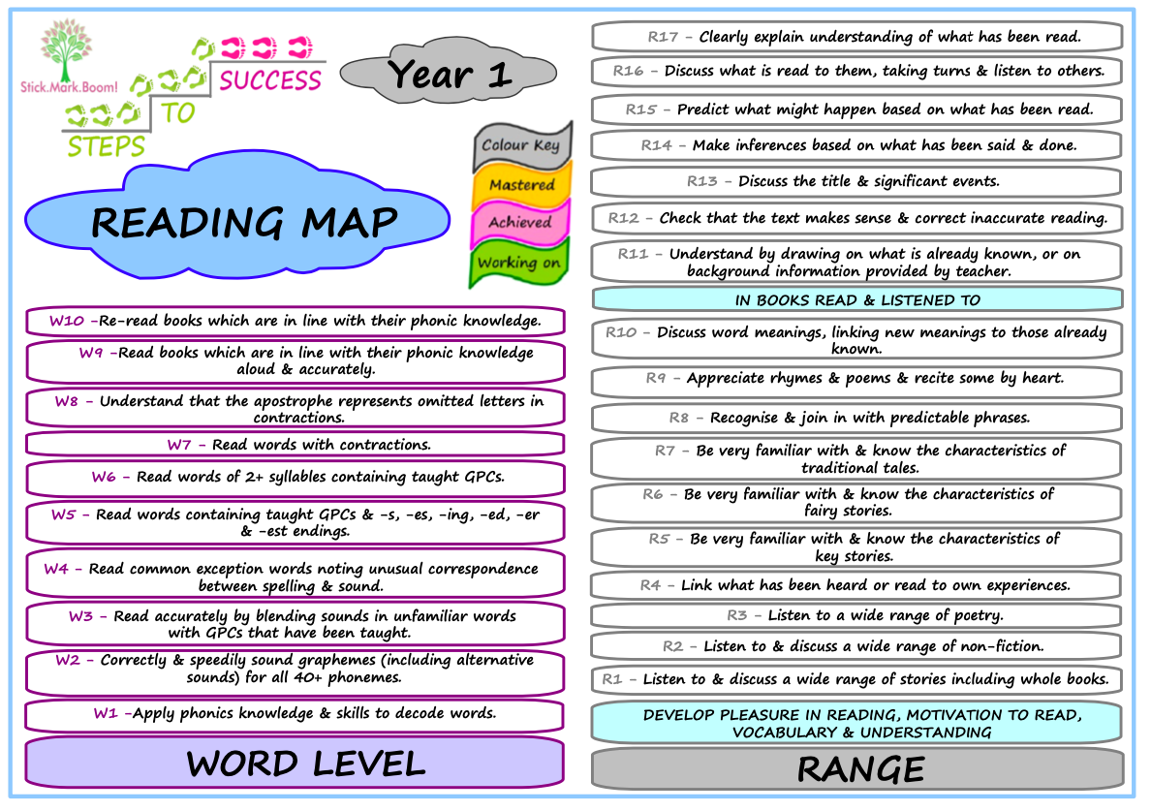

Slide 8
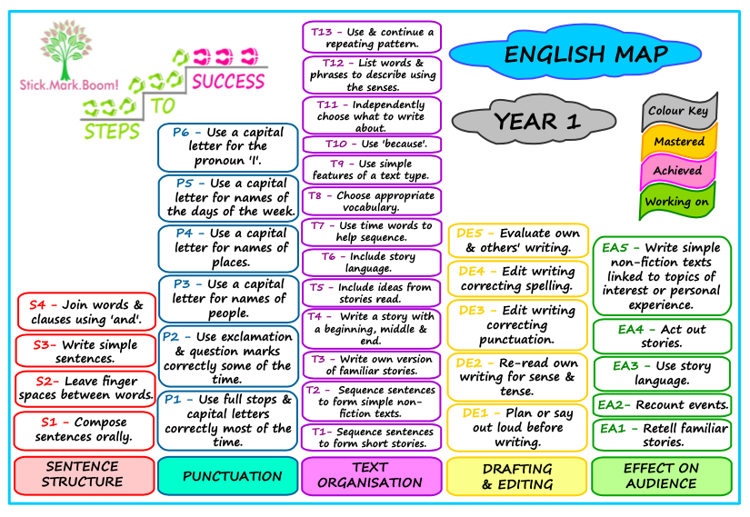

Slide 9
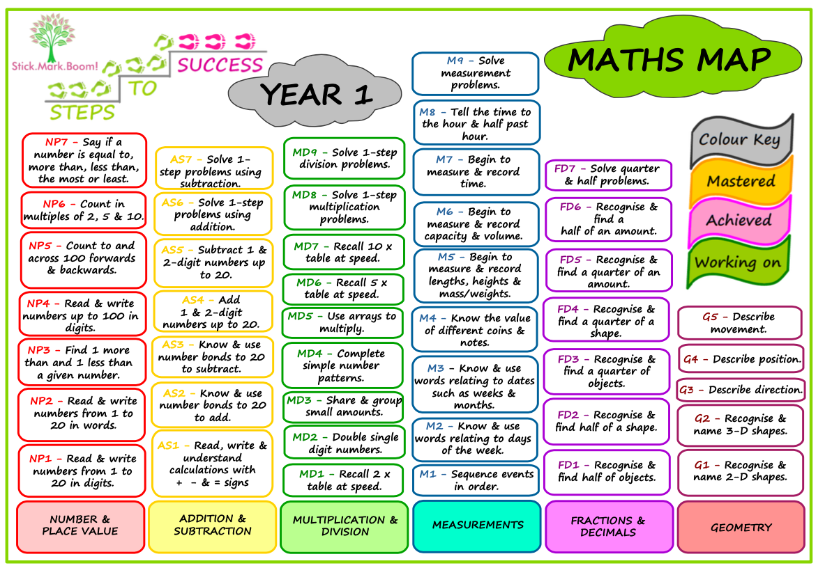

Slide 10
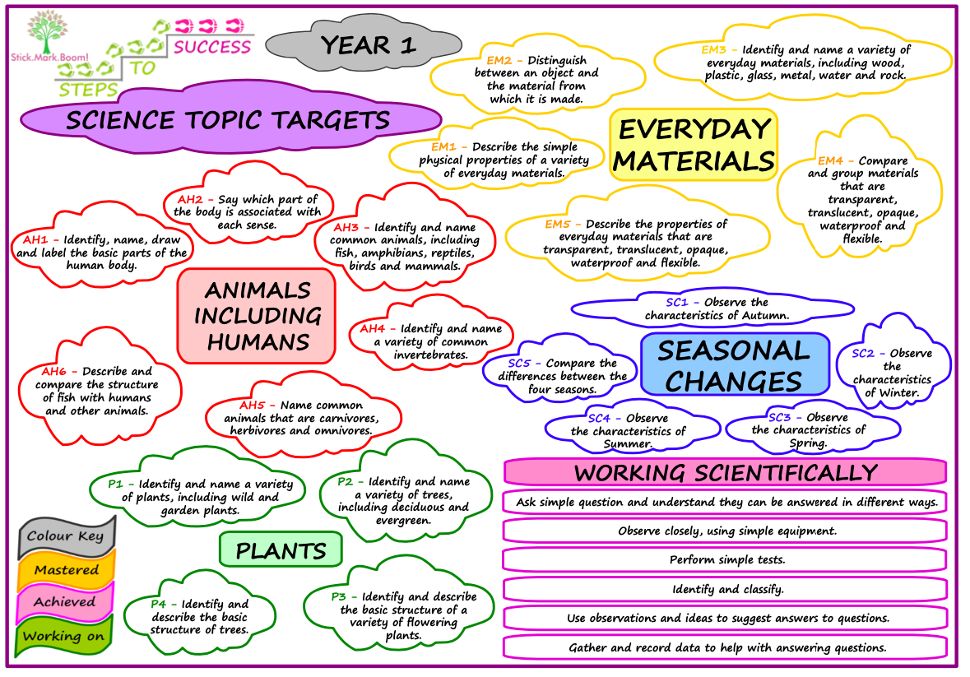

Slide 11

Home learning
Home learning is intended to reflect what we have been working on and is meant to help the children consolidate their learning and give them the opportunity to share their learning with you.
Each Friday I will upload ‘classwork’ onto Google Classroom where you can ‘turn in’ photos or videos of the children’s learning.
In Year 1 we will be focussing a lot on reading, phonics and handwriting but they will have curriculum tasks too which I try to make as creative as possible.
The high frequency words are essential this year, initially to read but then to write as well. We look for these in the children’s writing this year.

Slide 12
Phonics screening
The phonics screening check is a quick and easy check of your child’s phonics knowledge. It helps the school confirm whether your child has made the expected progress.
The national phonics screening check was introduced in 2012 to all Year 1 pupils in the country. It is a short, statutory assessment to ensure that children are making sufficient progress in the phonics skills to read words and are on track to become fluent readers who can enjoy reading for pleasure and for learning.
Your child will sit with the class teacher and will be asked to read 40 words aloud. The test normally takes a few minutes. If your child is struggling the teacher will stop the check. The check is carefully designed not to be stressful for your child.
The check consists of a list of 40 words, half real words and half nonsense words, the nonsense words will be shown to your child with a picture of an alien.
We will inform you on your child’s progress towards the end of the Summer term. If your child found the test tricky we will inform you of what support we have put in place to help them improve and what you can do at home to help them as well. Children who have not met the standard will retake the check in Year 2.

Slide 13
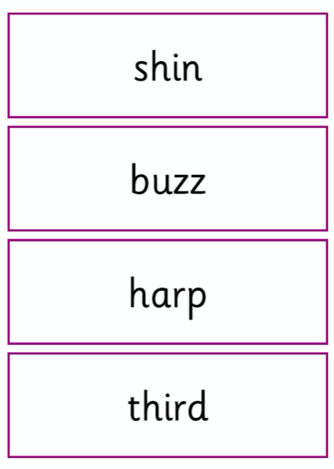
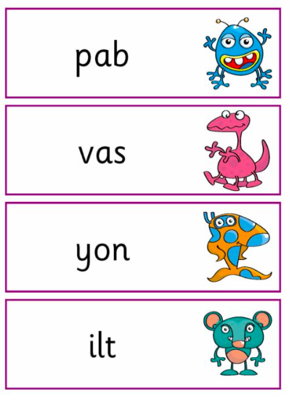

Slide 14
How you can help at home…
Get your child to tell you about what they are reading. Who is their favourite character and why? Is there anyone like that in your family? What do they think is going to happen? What have they learnt from their reading? Does it remind them of any of their own experiences?
Help your child with any words they don’t understand – look them up together in the dictionary if you need to.
Read recipes, instructions, manuals, maps, diagrams, signs and emails. It will help your child to understand that words can be organised in different ways on a page, depending on what it’s for.
Writing about their heroes, sports events, hobbies and interests helps your child to stay interested in what they are writing about.
Help your child to leave messages in sand on the beach, send a message in a bottle, do code crackers, word puzzles, crosswords, word finds – these are all fun to do together.
Make up a story about The Zoo and act it out with costumes and music. Write down the names of the characters.
If you or someone in your family has a computer, encourage your child to use it to write, email and publish or print for pleasure (emails, birthday cards, poems, jokes, letters, and pictures with captions). Or you could use a computer at the library.
Remind children to use a capital letter, finger spaces and a full stop in all their writing.

Slide 15
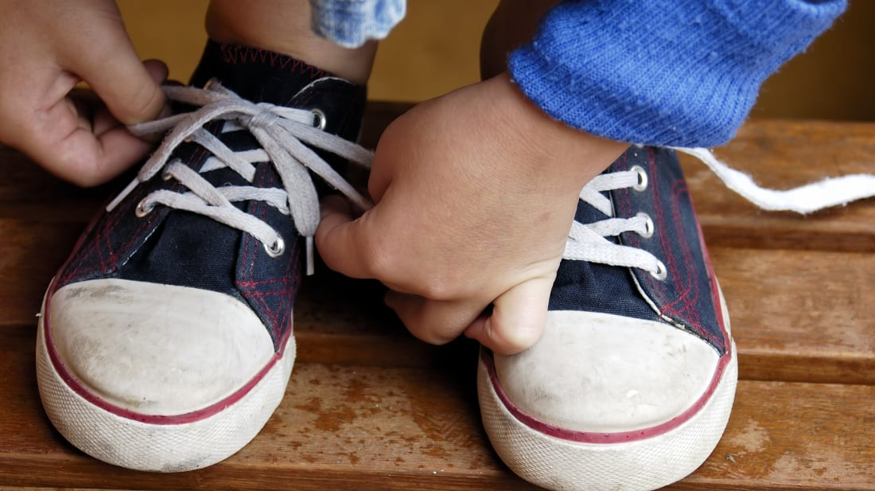


How you can help at home…
Find and connect numbers around your home and community – phone numbers, clocks, letterboxes, road signs, signs showing distance.
Count forwards and backwards (starting with numbers like 100, 99, 98, 97 then back again).
Make patterns when counting – forwards and backwards, starting with different numbers (73, 83, 93, 103, 113, 123… or 128, 118, 108, 98, 88, 78…).
Explore patterns through drumming, clapping, stamping, dancing.
Find out the ages and birth dates of family.
See patterns in the numbers in their times tables.
Keep practising forming your numbers the right way.
Help them develop independence…

Slide 16
Useful apps and websites…
https://www.phonicsplay.co.uk
https://www.topmarks.co.uk/Search.aspx?AgeGroup=2
https://uk.ixl.com/signin/sienarc
https://www.phonicsbloom.com
https://www.topmarks.co.uk/maths-games/hit-the-button
https://www.teachyourmonstertoread.com
https://www.bbc.co.uk/bitesize/topics/zd63xyc
https://home.oxfordowl.co.uk/kids-activities/fun-maths-games-and-activities/

Slide 17

Questions…

