Slide 1
Praying the Rosary KS2

Slide 2
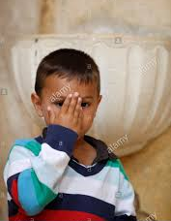
Let us join together, making the sign of the cross as a sign that we about to talk to God.
WE GATHER
In the name of the Father, and of the Son, and of the Holy Spirit, Amen.

Slide 3
The Rosary A Special Type of Prayer

Slide 4
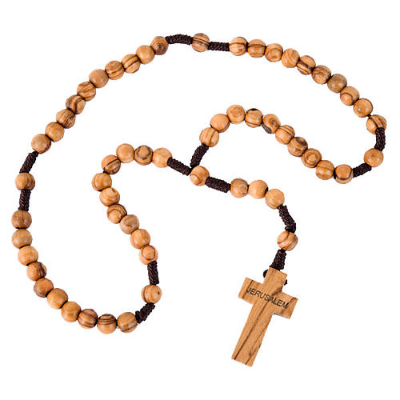
What is the Rosary?

Slide 6
We will watch Part 2 next time!

Slide 7
Why do we say the Rosary?

Slide 8
What prayers do we say for each bead?
We start here with the Apostles’ Creed.

Slide 9
The Apostles’ Creed
I believe in God, the Father Almighty, Creator of Heaven and earth; and in Jesus Christ, His only Son Our Lord, Who was conceived by the Holy Spirit, born of the Virgin Mary, suffered under Pontius Pilate, was crucified, died, and was buried. He descended into Hell; on the third day He rose again from the dead; He ascended into Heaven, and is seated at the right hand of God, the Father Almighty; from there He shall come to judge the living and the dead. I believe in the Holy Spirit, the Holy Catholic Church, the communion of saints,
the forgiveness of sins,
the resurrection of the body and life everlasting.
Amen

Slide 10
The Apostles’ Creed Say together:
Teacher: I believe in God, the Father Almighty, Creator of Heaven and earth;
Children: I believe that God made the world, the sky, the stars, the animals, and all the people in the world.

Slide 11
The Apostles’ Creed
and in Jesus Christ, His only Son Our Lord, Who was conceived by the Holy Spirit, born of the Virgin Mary,
I believe that God's Son, Jesus, came into the world from heaven. That's what we remember on Christmas.

Slide 12
The Apostles’ Creed
suffered under Pontius Pilate, was crucified, died, and was buried. He descended into Hell;
I believe that Jesus died on the cross for my sins, for all the wrong things I do.

Slide 13
The Apostles’ Creed
on the third day He rose again from the dead;
Three days after he died, he came alive again.

Slide 14
The Apostles’ Creed
He ascended into Heaven and is seated at the right hand of God, the Father Almighty;
He went into heaven, and now he is with his heavenly Father again.

Slide 15
The Apostles’ Creed
from there He shall come to judge the living and the dead.
I believe that someday he is going to come back to the world and I will see him.

Slide 16
The Apostles’ Creed
I believe in the Holy Spirit, I believe in the Holy Spirit, who is God, and lives inside me when Jesus is my Savior.

Slide 17
The Apostles’ Creed
the Holy Catholic Church, the communion of saints,
I believe that God loves the people in our church and that he wants me to love them too.

Slide 18
The Apostles’ Creed
the forgiveness of sins,
I believe that God forgives me all the wrong things I do because Jesus died for me.

Slide 19
The Apostles’ Creed
the resurrection of the body and life everlasting.
Amen
I believe that someday I will live on a new earth with God forever with my brand-new body!
Amen

Slide 20
The Our Father
Next, we say The Our Father.

Slide 21
Say together: The Our Father Our Father, who art in heaven, hallowed be thy name; thy kingdom come; thy will be done; on earth as it is in heaven. Give us this day our daily bread. And forgive us our trespasses, as we forgive those who trespass against us. And lead us not into temptation; but deliver us from evil. Amen

Slide 22
The Hail Mary
Next, we say three Hail Marys.

Slide 23
Say together: The Hail Mary three times Leader: Hail Mary full of Grace, the Lord is with thee. Blessed are thou amongst women and blessed is the fruit of thy womb Jesus. All: Holy Mary Mother of God, pray for us sinners now and at the hour of our death Amen

Slide 24
Say together: The Glory Be All: Glory be to the Father, and to the Son and to the Holy Spirit. As it was in the beginning, is now and ever shall be, world without end, Amen.

Slide 25
Next time, we will pray one decade of the Rosary.

