Slide 1

Praying the Rosary
KS1

Slide 2
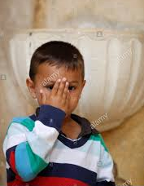

Let us join together, making the sign of the cross as a sign that we about to talk to God.
WE GATHER
In the name of the Father, and of the Son, and of the Holy Spirit, Amen.

Slide 3
The Hail Mary https://www.youtube.com/watch?v=7OxeUAtiuHk

Slide 4
The Our Father https://www.youtube.com/watch?v=nYDZkjBnUlM

