Slide 1

Praying the Rosary
KS2

Slide 2
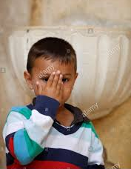

Let us join together, making the sign of the cross as a sign that we about to talk to God.
WE GATHER
In the name of the Father, and of the Son, and of the Holy Spirit, Amen.

Slide 3
The Rosary
A Special Type of Prayer

Slide 4
https://www.youtube.com/watch?v=QzmJ72mZFyg
Let’s watch the second part of our video about the history of the Rosary.

Slide 5
We are going to carry on praying the Rosary, starting with the first decade.

Slide 6
When you pray the Rosary, you focus on an aspect of Jesus’ life. This is called a Mystery.
We are going to pray the Joyful Mysteries, which tell about Jesus’ birth.

Slide 7
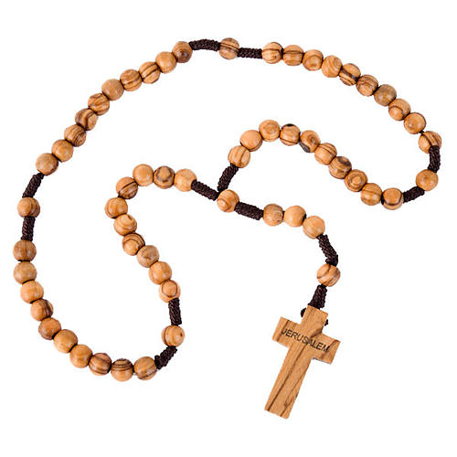
We announce the first mystery and the pray one Our Father.
The Annunciation

Slide 8
Say together:
The Our Father
Our Father, who art in heaven, hallowed be thy name; thy kingdom come; thy will be done; on earth as it is in heaven.
Give us this day our daily bread.
And forgive us our trespasses, as we forgive those who trespass against us.
And lead us not into temptation; but deliver us from evil.
Amen

Slide 9
Next we pray ten Hail Marys and end with a Glory Be.
As we pray each one, colour in a bead.

Slide 10
Say together:
The Hail Mary three times
Leader:
Hail Mary full of Grace, the Lord is with thee.
Blessed are thou amongst women and blessed is the fruit of thy womb Jesus.
All: Holy Mary Mother of God, pray for us sinners now and at the hour of our death
Amen

Slide 11
Say together:
The Glory Be
All:
Glory be to the Father, and to the Son and to the Holy Spirit. As it was in the beginning, is now and ever shall be, world without end,
Amen.

Slide 12
We have now prayed one Decade of the Rosary.

Slide 13
Let’s watch a brief clip about the mystery we have just prayed – The Annunciation. https://www.youtube.com/watch?v=yg3XpfrM6hM&t=220s
Please watch from 2.24 until the end of The Annunciation.

