Slide 1


Year 6 Meet the Teacher
Friday 2nd October 2020

Slide 2

We will be covering a lot of topics this afternoon.
If you have any questions, please use the chat feature to ask them and we will do our best to answer as many as we can.

Slide 3
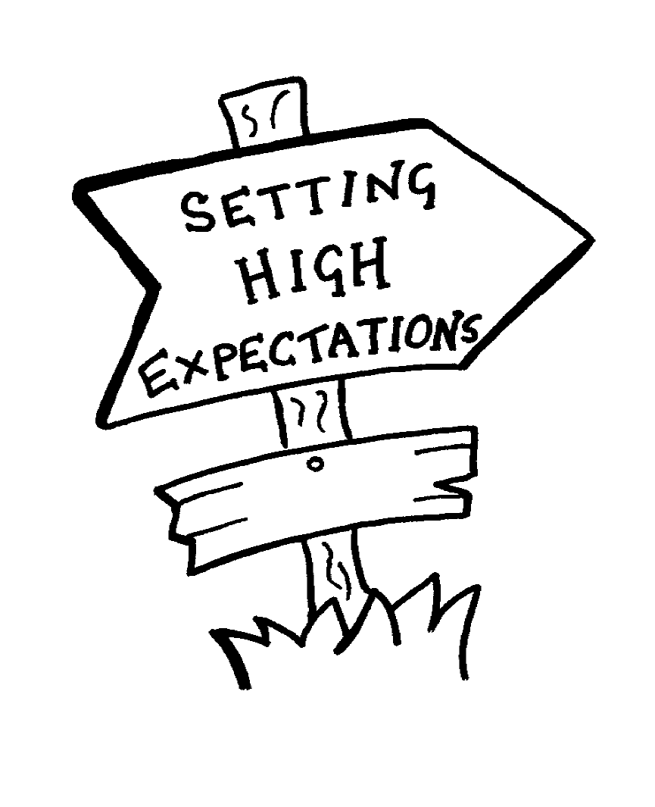
Expectations
- A lot of the things we do in Year 6 are to prepare the children for secondary school. We try to develop their independence and responsibility. For example, they need to pack their bags, remember letters and forest school kit etc. If they forget their forest schools kit for example, it is not because the parent forgot but because the child did. This will reflect secondary school where children may be given a detention for forgetting homework or equipment- it is therefore better for the children to become accustomed to this expectation now so it is not such a shock next year.
- To help the children, we have uploaded a weekly timetable to google classroom and the class page
of the school website. Children could print a copy and add on their after-school clubs, arrangements
for getting home etc. They can then create a list of what equipment they need on each day and
could use this to get themselves organised.
- Another idea could be for the children to have a notebook which they use to record letters
home/home learning which they can then tick off once it has been handed in.

Slide 4

Pencil Cases
- The children should be providing all of their equipment for their pencil cases.
- This includes if glue sticks/pens etc. run out.
- It is their responsibility to let you know when supplies run out and they need more.
- The school does not have supplies to give the children anymore.
- Pens cannot be biros and must use blue ink.

Slide 5

Friendships
In Year 6, we try to prepare the children as much as possible for secondary school and this includes dealing with friendship issues.
In secondary school, there may be much less time available to help the children to resolve problems as they arise and we therefore feel that it is important to prepare the children by giving them strategies to resolve their own issues as much as possible.
We try as much as possible, with smaller issues, to give the children some advice and strategies and then check back in with them to see if the problem is resolved- obviously if it is an ongoing issue, something more serious, or the child/children is in distress we will intervene.
We try to explain to the children that it is ok to need a break from our friends and sometimes what we need is a day or two playing with other people to prevent avoidable arguments. Equally, we need to be ok if our friends say that they need a break for a day or two- it is nothing personal.
We also talk to the children about explaining their feelings: “this upset me because…”. This is so important because if we don’t tell our friends that something they are doing is upsetting us, how will they ever change their behaviour?
We also talk about not taking sides, not getting involved in other people’s problems and discussing what is worth getting upset over and what we just need to shrug off.
We would be grateful if you would echo these pieces of advice at home.

Slide 6
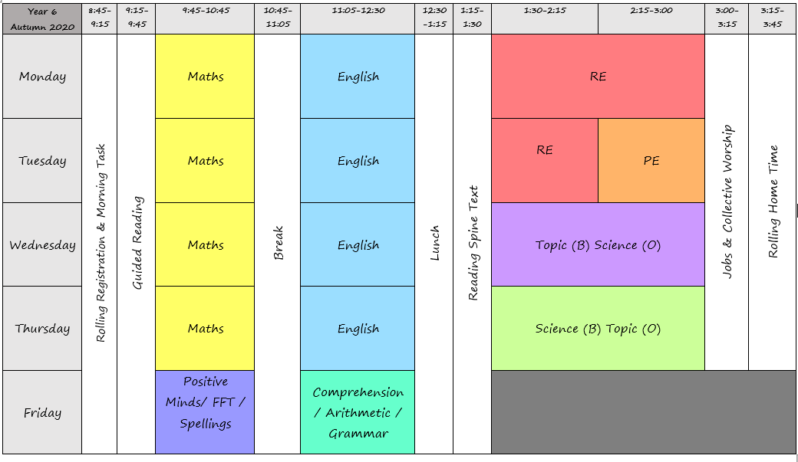
Timetable

Slide 7





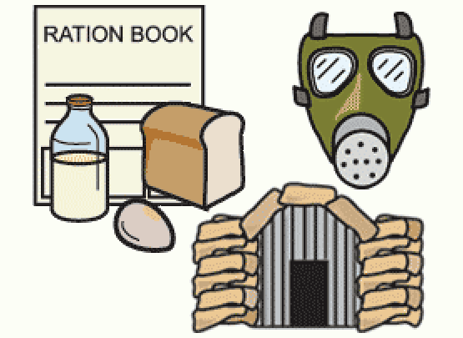

Topics

Slide 8

Writing
In Year 6, one of the expectations for their writing is that the handwriting is joined and legible- this is a government requirement. If the children have amazing content to their writing, but it is not joined, this can bring down their assessments.
There will be a lot of grammatical terms and new punctuation. This can be seen on the ITAF sent home and a grammar document will be being sent home to parents to explain these terms.
Quality over quantity!

Slide 9

Positive Minds
- We will be having weekly positive minds sessions on a Friday morning for ten weeks.
- These are planned, organised and run by Watford Football Club.
- They focus on different elements of mental health including anxiety, stress, body image, social media and people you can talk to.
- Although Watford are not coming in for these sessions due to COVID, we are still running the sessions using their online resources.

Slide 10
Home Learning / Homework
Weekly, the children should be:
- reading for half an hour per evening.
- practising their spellings.
- practising their times tables.
After the October half term, the children will be set weekly homework:
- a maths task.
- a grammar task.
- a reading comprehension task.
These are NOT optional. It is expected that these are turned in on google classroom by Friday.
Half termly, the children will be set an optional home learning task. This will be based around another area of the curriculum such as topic, science or RE.
This allows the children to complete a project based on their strength- art, writing, computing etc.

Slide 11

Bringing things in from home
Please do not let the children bring things in from home, including any home learning. This should be uploaded to google classroom instead.

Slide 12

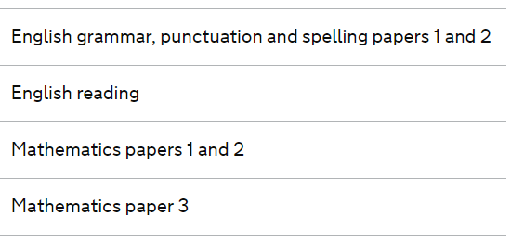
SATs
The key stage 2 tests are timetabled from Monday 10 May to Thursday 13 May 2021.
We will have a meeting nearer the time to discuss
SATs in more detail.
Please don’t panic about the tests!
We hope to be able to start boosters after February
Half term.
Detail will go out about these nearer the time.

Slide 13
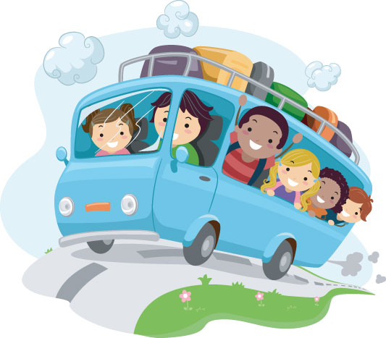
School Trips and Residentials
During the current time, we are unsure whether the usual school trips and residentials will be able to go ahead.
As soon as we know any information, we will keep you informed.

Slide 14

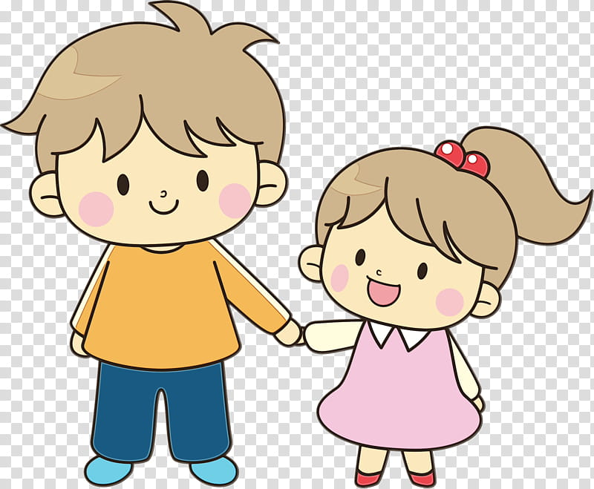
Buddies
The children have been assigned their buddies.
We will do our best to arrange opportunities for them to have a connection with their buddies but due to our bubbles, we cannot go to see them at the moment.

Slide 15

Social Media
- In Year 6, the children are often given phones and are therefore spending a lot more time on social media.
- Please remember that a lot of social media sites have a minimum age of 13. This is set for a reason.
- Please ensure that the children have the correct privacy settings on their accounts. They are NOT public and are not filming videos or taking pictures in school uniform, of other children without permission, using inappropriate language or outfits.
- Please ensure you are monitoring your child’s social media use, what is being said on social media, what is being filmed and posted and what messages they are receiving/sending.

