Slide 1
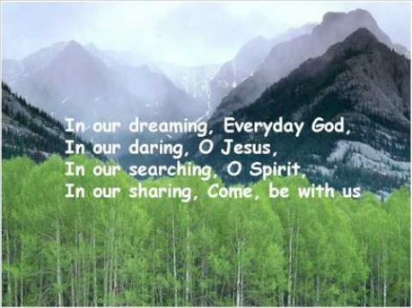

Slide 2


Collective Worship
Compassion

Slide 3
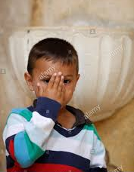
Let us join together, making the sign of the cross as a sign that we about to talk to God.
WE GATHER
In the name of the Father, and of the Son, and of the Holy Spirit, Amen.

Slide 4
WE LISTEN TO THE WORD OF GOD
Be kind and compassionate to one another, forgiving each other, just as Christ God forgave you.
— Ephesians 4:32

Slide 5


Slide 6

Learn how to sign ‘Compassion’…

Slide 7
GO FORTH
Throughout this week, try to show others compassion. Remember that you shouldn’t just show compassion to those you like, but to everyone.

Slide 8
Let us pray together:
A Prayer for Compassion
Jesus help my eyes to see, all the good you send for me.
Jesus help my ears to hear, calls for help from far and near
Jesus help my feet to go, in the way that you will show,
Jesus help my hands to do, all things loving, kind and true.
Amen

