Slide 1
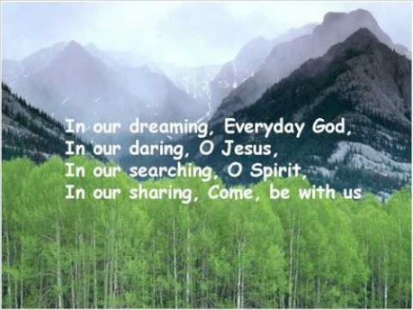

Slide 2

Collective Worship of Hope
2nd week of Advent

Slide 3
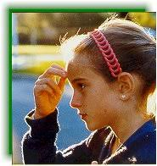
Let us join together, making the sign of the cross as a sign that we about to talk to God.
WE GATHER
In the name of the Father, and of the Son, and of the Holy Spirit, Amen.

Slide 4
Which Christmas carol is this from?
The hopes and fears of all of the years are met in thee tonight…..
This year has been a strange year or all our families and some have had many worries and fears and have clung onto hope.
Hope that there will be better times ahead. (which there will be).
Hope that we will get a vaccine (which we will).
We rely on our faith to give us the hope so that fear does not take over.

Slide 5
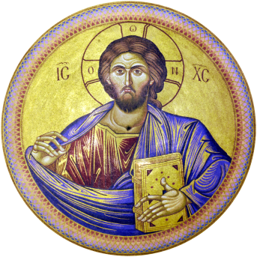
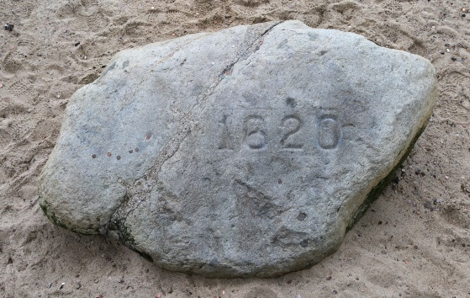

What is Christian Hope?
Not a wish or a feeling?
An anchor
Something that provides a
solid rock
A foundation

Slide 6
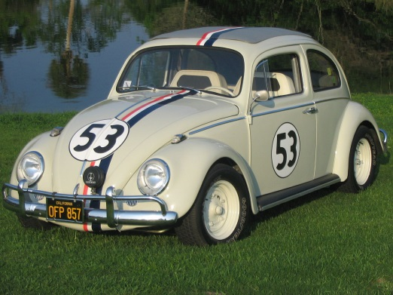
Do you have Christian hope?
Christian hope does not come from us, it is our response to what God
Promises. God should be put first.
When we seek God it is a result of him first seeking us.
We all need hope for the future we cannot live without it.
Hope is like headlights on a car. It is not easy to drive without headlights in the dark.

Slide 7
WE RESPOND
Close your eyes or focus on the candle. Make sure that you are comfortable.
Think about how you are gong to show your Christian hope this week?
Let us ask God to guide us in our Christian hope. Remember God can give us peace. He tells us ‘do not be afraid’ and we should not . God is there for us to lean on. When we need him he will carry us and be there for us.

Slide 8
WE LISTEN TO THE WORD OF GOD
Psalm 25:4-5 – Show me the right path, O Lord; point out the road for me to follow. Lead me by Your truth and teach me, for You are the God who saves me. All day long I put my hope in You.
Psalm 119:147 – I rise early, before the sun is up; I cry out for help and put my hope in Your Words.
Psalm 78:7 – So each generation should set its hope anew on God, not forgetting His glorious miracles and obeying His commands.

Slide 9

The Pencil of Hope
5 Qualities
I wanted to share the story of my pencil with you which my dad gave to me when I was your age and he called it the Pencil of Hope.
It is the hand of God that guides us.
We use a sharpener which means the pencil may suffer a little this reminds God wants us to stay on.
us that in life we too need to experience some pain but that it will make us a better person.
The rubber allows us to rub out any mistakes we make. This reminds us to keep on the right path
– the one God wants us to stay on in life.
It is not how the pencil looks on the outside but what is happening in side. It reminds us to pay
attention to what is happening inside us each day.
5. A pencil leaves a mark, just as God reminds us that all we do in life leaves a mark or a footprint. sometimes Jesus walks beside us and other time when his footprints cannot be seen he is carrying us with hope until we are strong enough to walk on our own again.

Slide 10
As we close our Collective Worship, think about how you can you can put your Christian hope in God this week. We want to know there is something better coming if we trust in him.
Say your prayers daily and reach out to God.
Make good choices and show others your hope as you continue to prepare for Jesus birthday.
Remember your 5 pencil qualities.

Slide 11
MEDITATION
https://www.youtube.com/watch?v=Q2iQKO77xR8
Hope can be found in trusting in God and asking him to help you show the way, through daily prayer.
God hears your prayers and listens to his children.

Slide 12
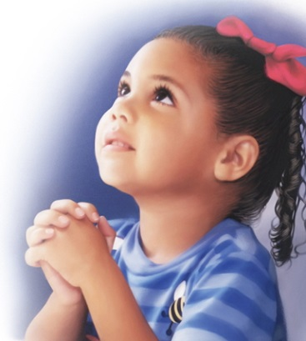
Let us ask God to help us, through prayer and conversation with him, show him that by standing on his rock, the foundation of life,we will in turn live good lives..

Slide 13
Let us join together in reading our prayer:
God of hope who brought us into this world,
Be the love that dwells between us.
God of hope, who brought peace into this world,
Be the love that dwells between us.
God of hope, who brought joy into this world,
Be the joy that dwells between us.
God of hope, the rock we stand on,
Be the foundation of our lives.
Amen.

Slide 14
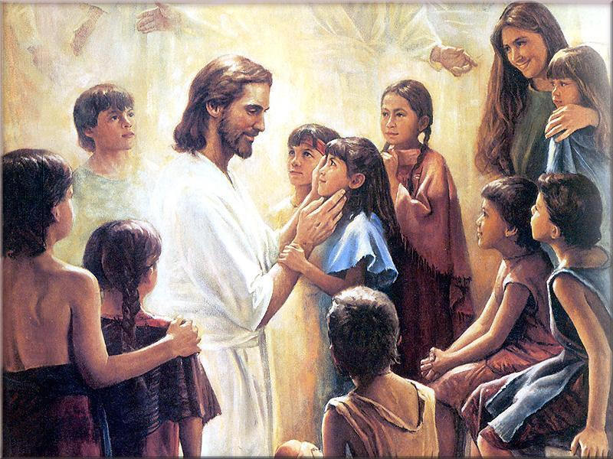
Watch/Think/Practise/Achieve https://www.youtube.com/watch?v=bkeI8C2CJz0
Remember our hope is in God.
He alone is our rock and our salvation from which we will not be shaken.
Make an Anchor as a symbol of hope.
Make a hope tree of life as a centre piece
Send some messages of hope to those people in your life.
Give a pencil to someone you feel is finding this week difficult.

