Slide 1
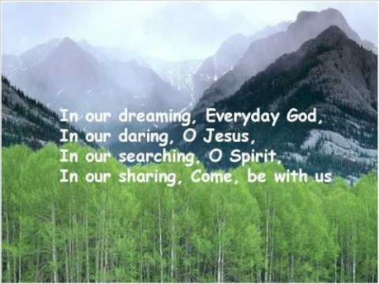

Slide 2

Collective Worship
Justice

Slide 3
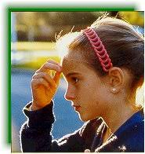
Let us join together, making the sign of the cross as a sign that we about to talk to God.
WE GATHER
In the name of the Father, and of the Son, and of the Holy Spirit, Amen.

Slide 4

What is Justice?
Getting a fair deal
Morally the right thing to do.
Receive what you deserve
Fairness

Slide 5
Are you good at accepting Justice even if it means you might be wrong?
I am going to read a little story and let you think whether Barney
did the right thing.
Reflection
Sometimes an action may not be illegal but it might not be fair.
Barney thinks he is offering Bob a good deal. What do you think?

Slide 6
WE RESPOND
Close your eyes or focus on the candle. Make sure that you are comfortable.
Think about how you are gong to act our our value this week of justice.
Let us ask God to guide us in allowing us to make the right choices, the fairest choices and ones that are morally right.

Slide 7
WE LISTEN TO THE WORD OF GOD
Luke 19: 1-10
For when they have finished talking Zaccheaus had a change of heart.
“I am giving half of all my money to the poor and if I have cheated anyone, I will repay what I have stolen, four times over.”

Slide 8
As we close our Collective Worship, think about how you treat others around you.
Find time to always ask God to help you make the right decisions.
Remember to treat those who are smaller or weaker than you are with justice.

Slide 9
MEDITATION
https://www.youtube.com/watch?v=uuZEJ5h1AU8
Satisfaction is gained by achieving success through honest dealings.
Do good and seek justice.
Turn to God and ask him are you doing the right thing and will he be happy with your actions?

Slide 10
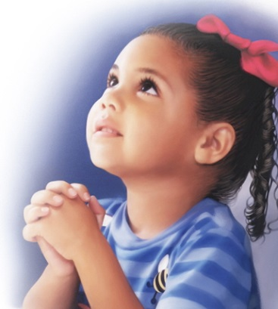
Let us ask God to help us, through prayer and conversation with him to do good and seek justice always.

Slide 11
Let us join together in reading our prayer: (repeat after me).
After each line of this prayer, say the response.
When we face difficult choices about how to act,
All: Help us learn to do good and seek justice.
When we face difficult choices about what to say,
All: Help us learn to do good and seek justice.
When we face difficult choices about money,
All: Help us learn to do good and seek justice.
We know that by ourselves, we will sometimes struggle to do the right thing, so, May God the Father encourage us, God the Son befriend us, And God the Holy Spirit support us. Amen.

Slide 12
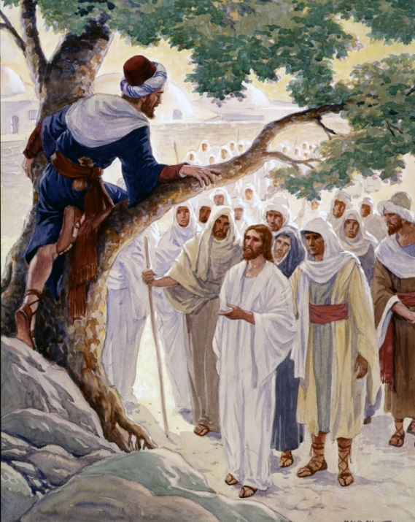
Watch/Think/Practise/Achieve https://www.youtube.com/watch?v=PxTvIiokPm4
Remember how Jesus treated everyone fairly no matter their mistakes.
Today he encourages us to make just decisions too.
Learn our justice song and sing as a class to remind you of our value this week.
Act out Barney’s story or similar.
Write your own ‘Justice’ Prayer and share with your class during prayer time.
Make some bread/play dough and see if you can
Divide it equally.

