Slide 2
Collective Worship Remembrance Day

Slide 3
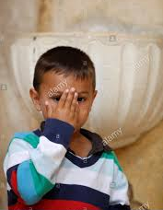
Let us join together, making the sign of the cross as a sign that we about to talk to God.
WE GATHER
In the name of the Father, and of the Son, and of the Holy Spirit, Amen.

Slide 4
WE LISTEN TO THE WORD OF GOD John 15:13 – Greater love has no one than this, that one lay down his life for his friends.

Slide 5
What is Remembrance or Poppy Day? KS2

Slide 6
What is Remembrance or Poppy Day? KS1/EYFS

Slide 7
Activity

Slide 8
Let us pray together:

