Slide 1
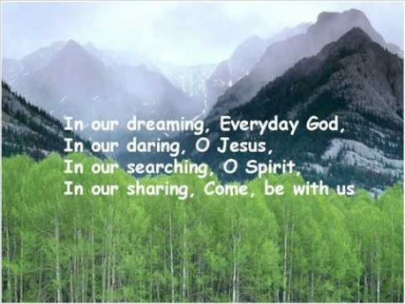

Slide 2

Collective Worship
Forgiveness

Slide 3
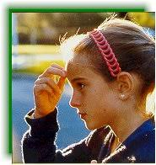
Let us join together, making the sign of the cross as a sign that we about to talk to God.
WE GATHER
In the name of the Father, and of the Son, and of the Holy Spirit, Amen.

Slide 4
What is forgiveness?
Are you able to forgive?

Slide 5




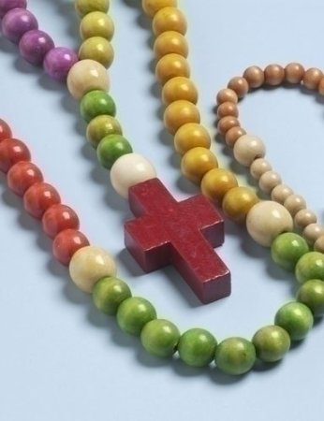

How can you show you are a forgiving person?

Slide 6
WE RESPOND
Close your eyes or focus on the candle. Make sure that you are comfortable.
Think about how you are gong to practice being more forgiving this week.
Let us ask God to guide us in showing forgiveness just as he forgave those who hurt him and went against him.

Slide 7
WE LISTEN TO THE WORD OF GOD
Be kind to one another, tender hearted to one another, and forgive one another, as God has forgiven you through Christ. Ephesians 3 32
And whenever you stand praying, forgive, if you have anything against anyone, so that your in heaven will forgive the wrongs you have done.” Mark 11 25-27

Slide 8
MEDITATION
https://www.youtube.com/watch?v=Q2iQKO77xR8
Forgiveness is the key to answered prayers. It is the foundation of your relationship with God. Prayer is one way in which we connect with God, and talk to him about what's happening in our lives.

Slide 9
As we close our Collective Worship, think about how you can be a more forgiving person.
Can you find a way to focus on the ‘Now’ say ‘Yes’ to letting go of upset and anger?
Can you allow peace to enter your life so that you can forgive graciously?

Slide 10
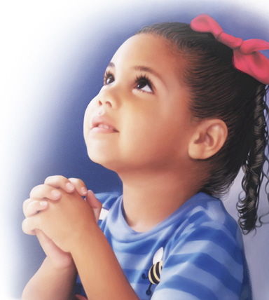
Let us ask God to help us through prayer in forgiving those who have hurt or angered us.

Slide 11
Let us join together in reading our prayer: (repeat after me).
Loving God,
Guide me in the power of choice.
Open up my heart so that peace and joy can be a daily part of my life.
Help me to smile everyday and show how grateful I am for my friends and family.
Amen.

Slide 12


Watch/Think/Practise/Achieve https://www.youtube.com/watch?v=kZ_wCZ1gPN4
Remember God is always forgiving, lets try and be more like God this week.
Make a cross and put it somewhere to remind you that Jesus forgave all who hurt him.
Start your class rosary to gain strength for forgiveness through prayer.
Smile and move on – be a good friend.
Make something for a friend who you have forgiven. –

