Slide 1
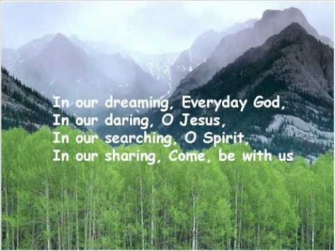

Slide 2
Recap on our values
Self belief
Respect
Patience
Friendship
Cooperation
Forgiveness

Slide 3

Collective Worship
Perseverance

Slide 4
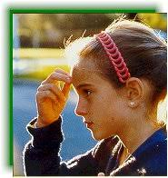
Let us join together, making the sign of the cross as a sign that we about to talk to God.
WE GATHER
In the name of the Father, and of the Son, and of the Holy Spirit, Amen.

Slide 5
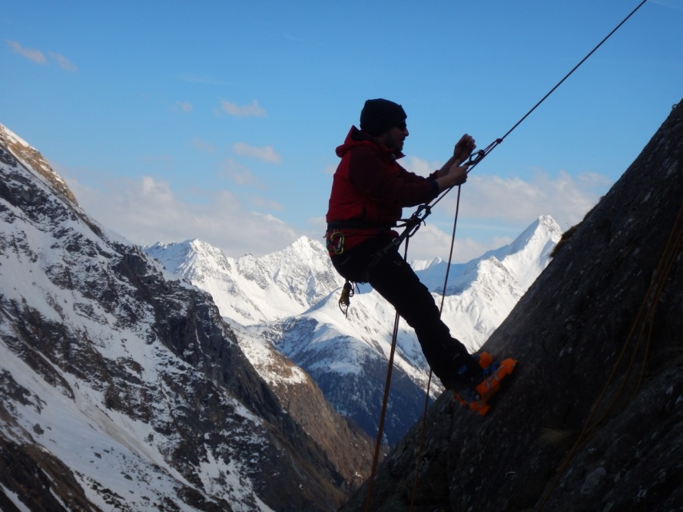
What is Perseverance?
Determination
Never giving up
Keep on trying
Persistence
Resilience

Slide 6
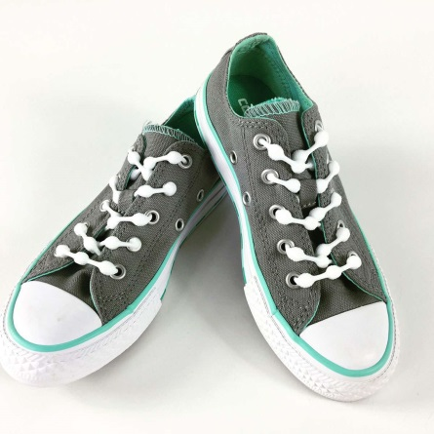
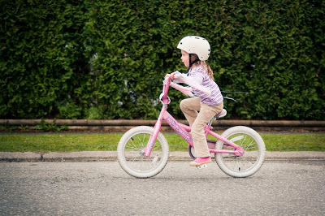
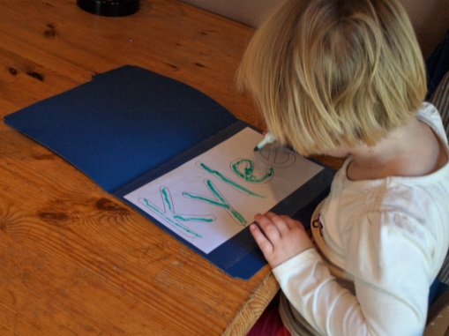
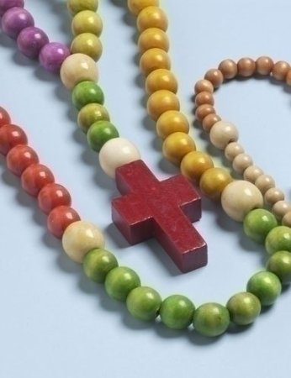

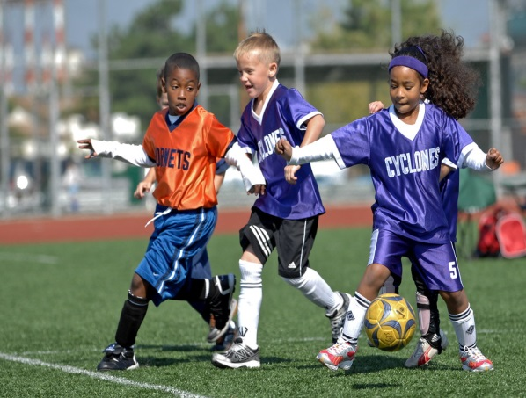
What things may you have to persevere at?

Slide 7
WE RESPOND
Close your eyes or focus on the candle. Make sure that you are comfortable.
Think about how you are gong to show your perseverance this week?
Let us ask God to guide us in showing determination just as Jesus showed his determination and perseverance on all those who hurt him.

Slide 8
WE LISTEN TO THE WORD OF GOD
Suppose one of you has a hundred sheep and looses one of them – what do you ? Luke 15: 1-6

Slide 9
As we close our Collective Worship, think about how you can you will persevere when you find a task difficult.
Can you find a way in your heart to not give up easily?
Can you allow strength to enter your life so that you can achieve beyond your expectations?

Slide 10
MEDITATION
https://www.youtube.com/watch?v=Q2iQKO77xR8
Perseverance can be found in trusting in God and asking him to help you. Prayer will reap rewards.
God hears your prayers and listens to his children.

Slide 11
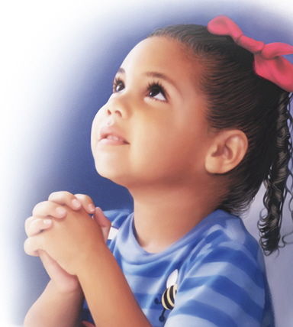
Let us ask God to help us, through prayer and conversation with him, to keep directing us in all the challenges that life brings.

Slide 12
Let us join together in reading our prayer: (repeat after me).
Loving God,
Help me to be strong when I want to give up.
Help me to move beyond the hurdles that trip me up.
Give me strength and wisdom to look up and see the hope you have in me.
Amen.

Slide 13
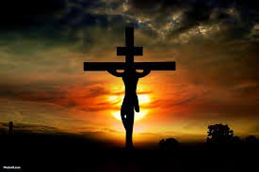
Watch/Think/Practise/Achieve https://www.youtube.com/watch?v=QJOdesUkYdU https://www.youtube.com/watch?v=30YP_-qws7s
Remember Jesus is our greatest example of perseverance as he died on the cross for us.
Make time to say your rosary. It may not be easy so persevere.
Make a class sheep to remind you never to give up.
Celebrate an achievement which you have struggled to overcome.
Make up a special prayer for perseverance.

