Slide 1
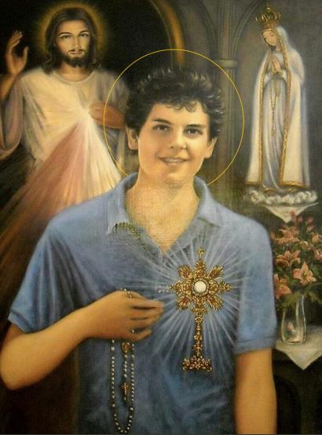

“To always be close to Jesus, that is my life plan”
Carlo Acutis

Slide 2

“For the first time in history we will see a saint dressed in jeans, sneakers, and a sweater”
“This is a great message for us, we can feel holiness not as a distant thing but as something very much within everyone’s reach because the Lord is the Lord of everyone.”

Slide 3
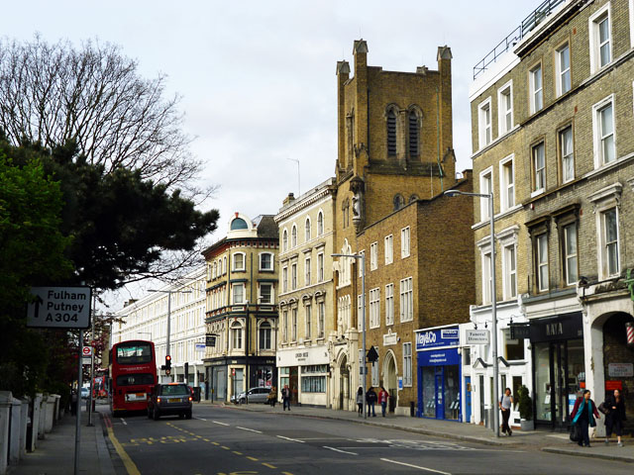
Carlo Acutis was born on 3rd May 1991, in Fulham, London. His parents were Italian but were living in the UK for work.

Slide 4
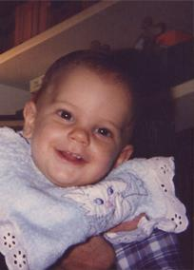
Just a few months after Carlo was born, his parents, Andrea Acutis and Antonia Salzano, moved their family to Milan.
Photo from www.carloacutis.com

Slide 5
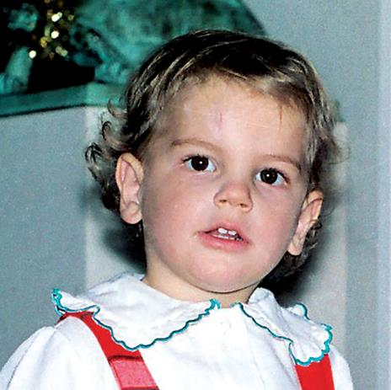
From a young age, Carlo seemed to have a special love for God, even though his parents weren’t particularly devout Catholics.
Photo from www.carloacutis.com

Slide 6
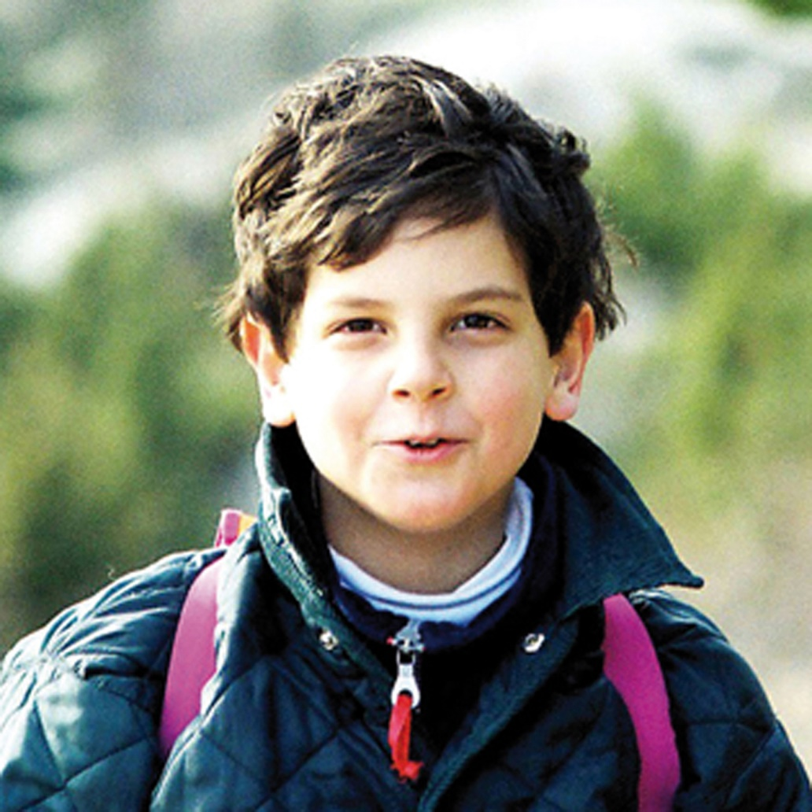
Even when he was just a little boy, Carlo loved to pray the rosary. After he made his First Holy Communion, he went to Mass as often as he could and went to confession weekly.

Slide 7

Carlo loved playing video games. He had a PS2, which was released in 2000, when Carlo was nine.
Although he loved to game, Carlo only allowed himself to play for an hour a week, as a penance and a spiritual discipline.

Slide 8
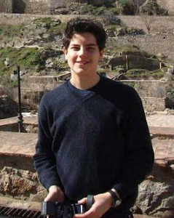
He asked his parents to take him on pilgrimages — to the places of the saints, and to the sites of Eucharistic miracles.
Photo from www.carloacutis.com

Slide 9
As a teenager, Carlo was tragically diagnosed with leukaemia.
One of the doctors treating Carlo asked him if he was in very much pain and he answered "there are people who suffer much more than me".

Slide 10
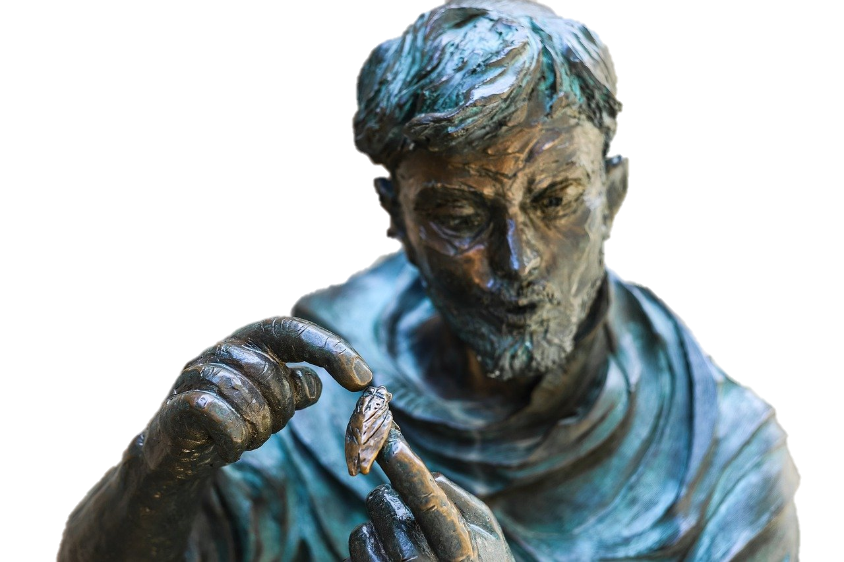
Carlo sadly died on 12th October 2006, and was buried in Assisi.
He asked to be buried in this particular place because of his love for St. Francis of Assisi.

Slide 11
The fruits of Carlo’s life

Slide 12
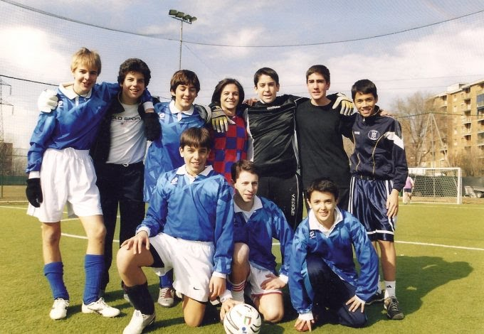
Carlo was known for defending children at school who were picked on, particularly children with special needs. He was a natural leader, but his leadership was in service of others.
Photo from www.carloacutis.com
The fruits of Carlo’s life

Slide 13
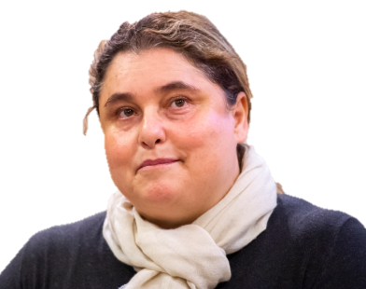
According to the priest promoting his cause for sainthood, Carlo’s witness of faith led to a deep conversion in his mother.
“He managed to drag his relatives, his parents to Mass every day. It was not the other way around; it was not his parents bringing the little boy to Mass, but it was he who managed to get himself to Mass and to convince others to receive Communion daily.”
Photo by:
Antoine Mekary | ALETEIA
The fruits of Carlo’s life

Slide 14
Carlo promoted Eucharistic miracles, especially through a website he built specifically. He was 11 when he built the site!
On the site, he told people
"the more often we receive the Eucharist, the more we will become like Jesus, so that on this earth we will have a foretaste of heaven."
The fruits of Carlo’s life

Slide 15
Carlos's mother Antonia Salzano said
“He was considered a computer genius because he knew logarithms, he knew how to make programs and read university texts on these topics. But what did he do? He didn't use these media to chat, have fun, or anything like that. His zeal for the Lord and his love for the knowledge of Jesus prompted him to use his talents to create a website on Eucharistic miracles and an exhibit on the same subject that has travelled around the world".
The fruits of Carlo’s life

Slide 16
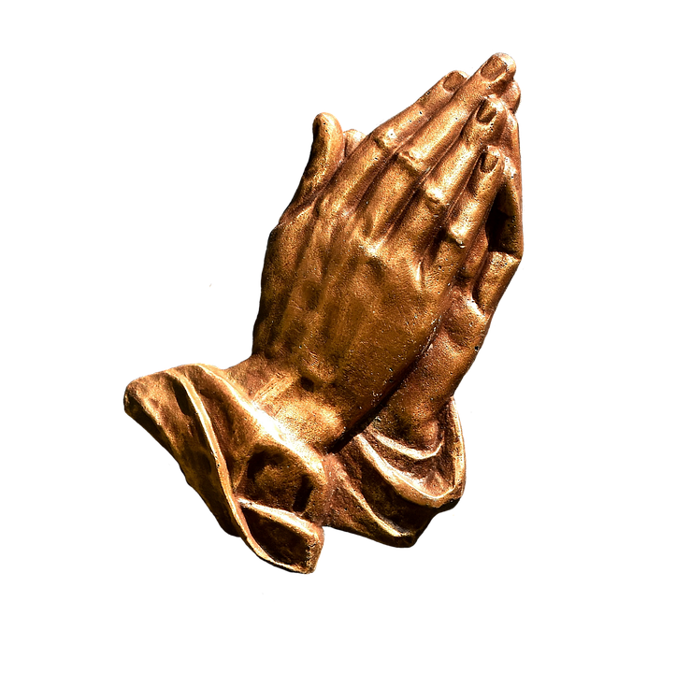
When Carlo became ill, his faith life increased.
He offered up his suffering for the Church, the pope, and for people who were suffering with illness.
The fruits of Carlo’s life

Slide 17
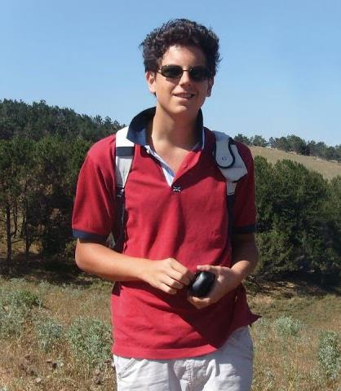
The calls for Carlo to be beatified began not long after he died and became more serious in 2013 after the cause commenced and he was given the title ‘a Servant of God’ - the first stage on the path towards sainthood.
In 2018 Pope Francis declared Carlo to be ‘venerable’.
Photo from www.carloacutis.com

Slide 18
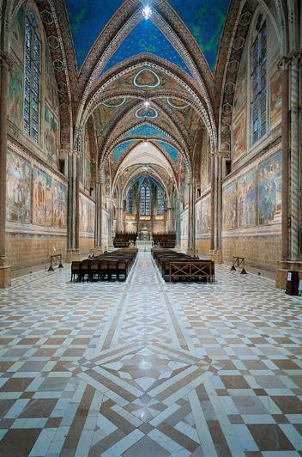
A miracle has been attributed to the intercession of Carlo, a Brazilian boy was cured from a rare disease.
Carlo will be beatified in the Basillica of San Francesco, Assisi on 10th October.

Slide 19
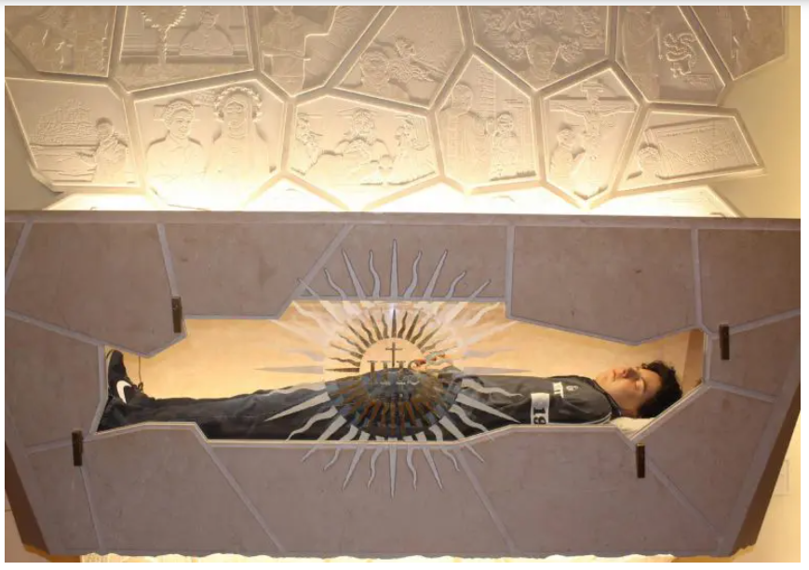
The tomb of Carlo Acutis has been opened for veneration before his beatification in Assisi.
Photos courtesy of Assisi diocese

Slide 20
“Carlo’s life can teach many young people that a
normal life can become extraordinary if we put
God at the centre and walk in harmony with
God's plan for us. Carlo did this. ”
Carlo’s Mother

Slide 21
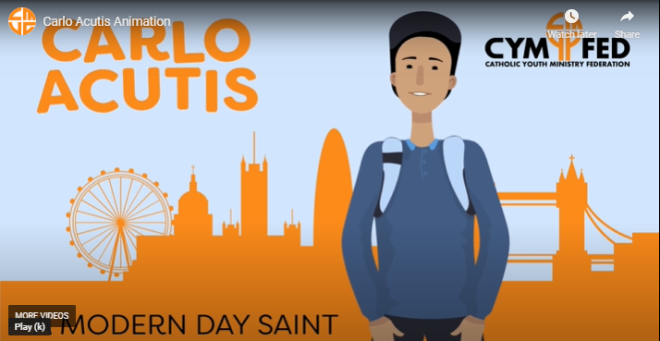
CLICK FOR VIDEO REFLECTION ON CARLO

