Slide 1
Phonics and reading workshop
Tuesday 2nd November, 2021

Slide 2

At St Catherine of Siena, we follow the Floppy Phonics programme. Floppy phonics is a phonics resource published by Oxford Reading tree and consists of 5 phases.

Slide 3
Terminology
Phoneme- the sound
Grapheme- the written
Segmenting and blending
Digraph- 2 letters with 1 sound (ch)
Trigraph- 3 letters with 1 sounds (igh)
Split digraph- a_e e_e i_e o_e u_e

Slide 4
Before phonics begins…
Environmental
Instrumental sounds
Body Percussion
Rhythm and rhyme
Alliteration
Voice sounds
Oral blending and segmenting.

Slide 5
First…
s, a, t, p, i, n, m, d, g, o, c, k, ck, e, u, r, h, b, f, ff, l, ll, ss
Cat, tin, fill, hiss, dog…

Slide 6
Then…
j, v, w, x, y, z, zz, qu
Consonant digraphs: ch, sh, th, ng
Vowel digraphs: ai, ee, igh, oa, oo, ar, or, ur, ow, oi, ear, air, ure, er

Slide 7
Next…
Stage 4 or Phase 4 consolidates all the children have learnt in the previous phases and introduces new tricky words.

Slide 8
Last…
Children will be taught new graphemes and alternative pronunciations for these graphemes.
Vowel digraphs: wh, ph, ay, ou, ie, ea, oy, ir, ue, aw, ew, oe, au
Split digraphs: a_e, e_e, i_e, o_e, u_e

Slide 9
spag (spelling, punctuation and grammar
The focus is on learning spelling rules.
-s -es -ing -ed
-er -est -y -en
-ful -ly -ment -ness

Slide 10
Segmenting
Breaking down words for spelling.
cat
c a t

Slide 11
Blending
Building words from phonemes to read.
c a t
cat

Slide 12
Segmenting
queen
qu ee n

Slide 13
Blending
qu ee n
queen

Slide 14
What does a Phonics lesson look like?
Revisit/review | Flashcards to practice phonemes learnt so far.
Teach | Teach new phoneme air
Practice | Buried treasure air, zair, fair, hair, lair, pair, vair, sair, thair
Apply | Read captions: It is fun at the fair. I have a pair of socks.

Slide 15
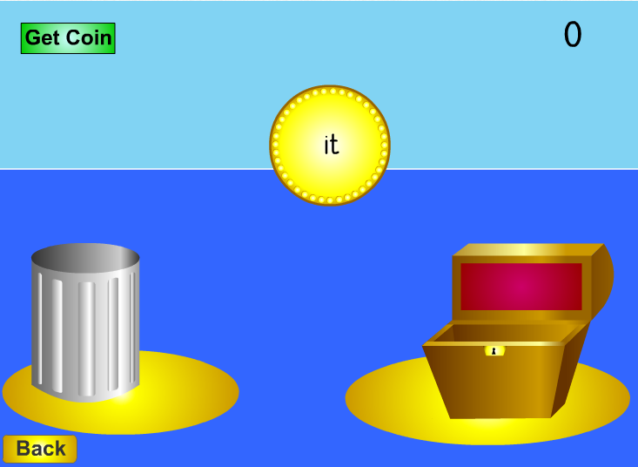
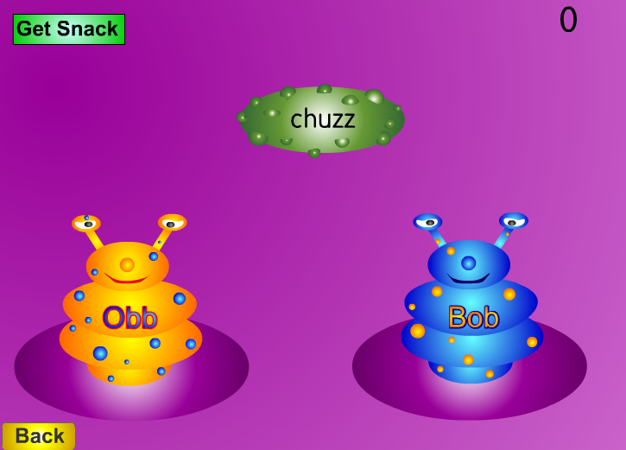
Resources
http://www.phonicsplay.co.uk

Slide 16
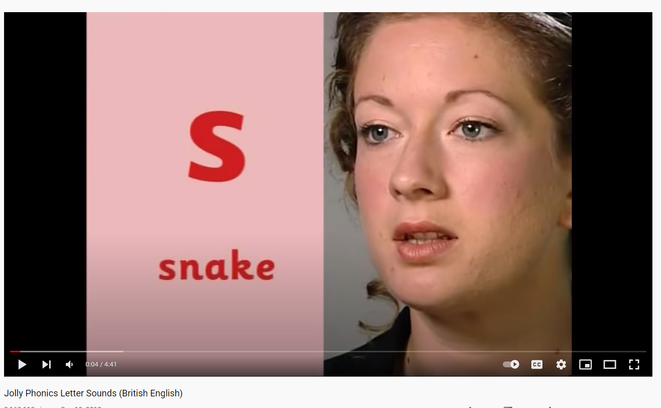
https://www.youtube.com/watch?v=-ksblMiliA8

Slide 17
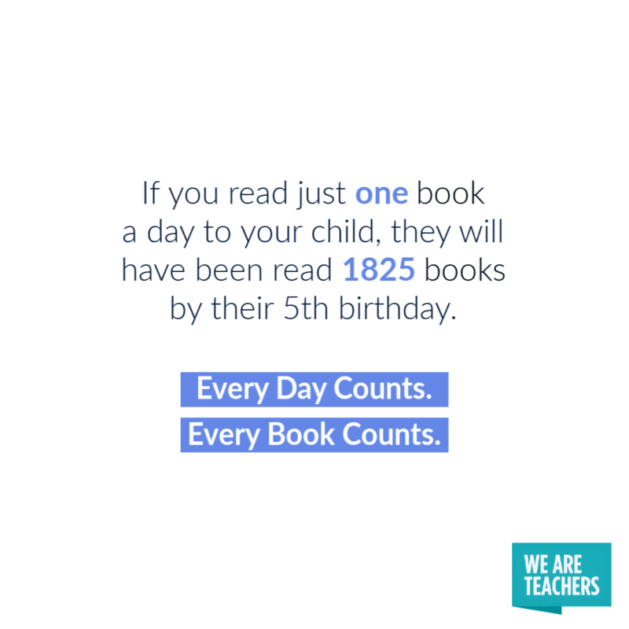

Slide 18
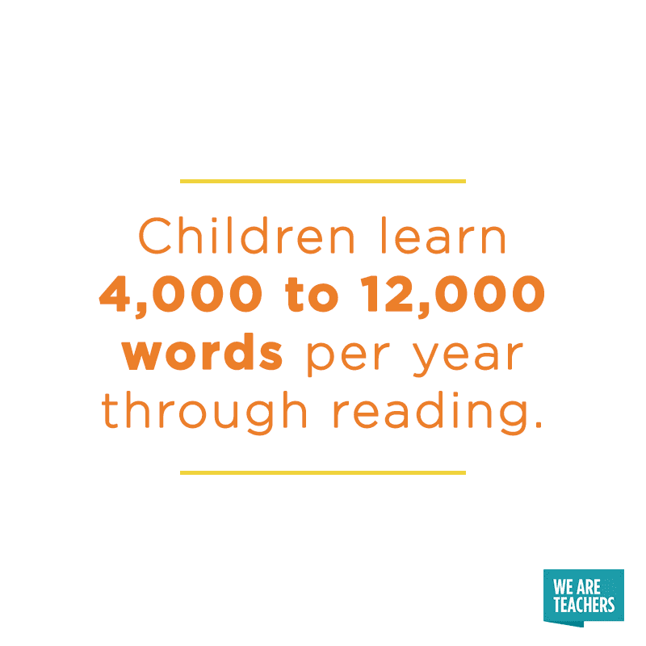

Slide 19
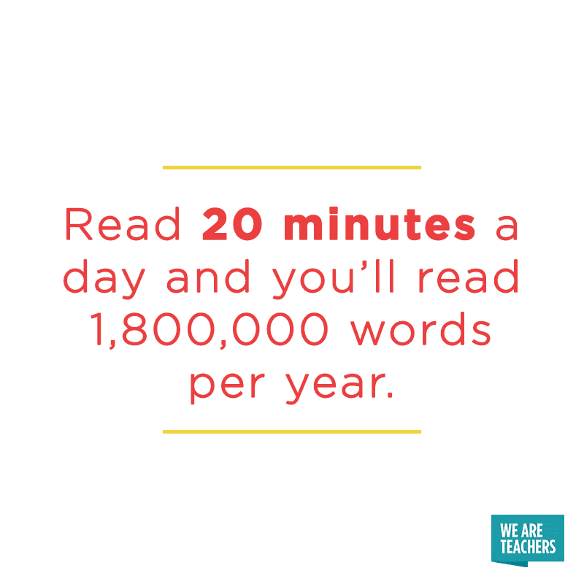

Slide 20
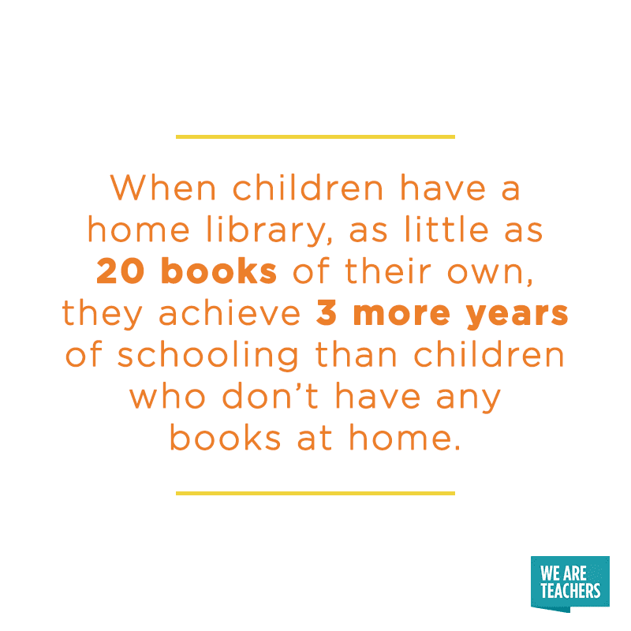

Slide 21
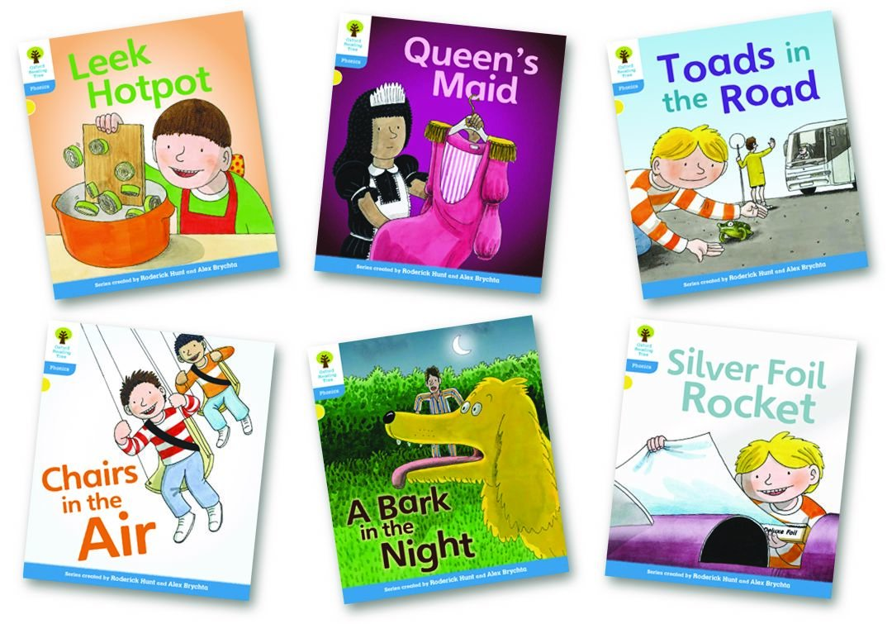
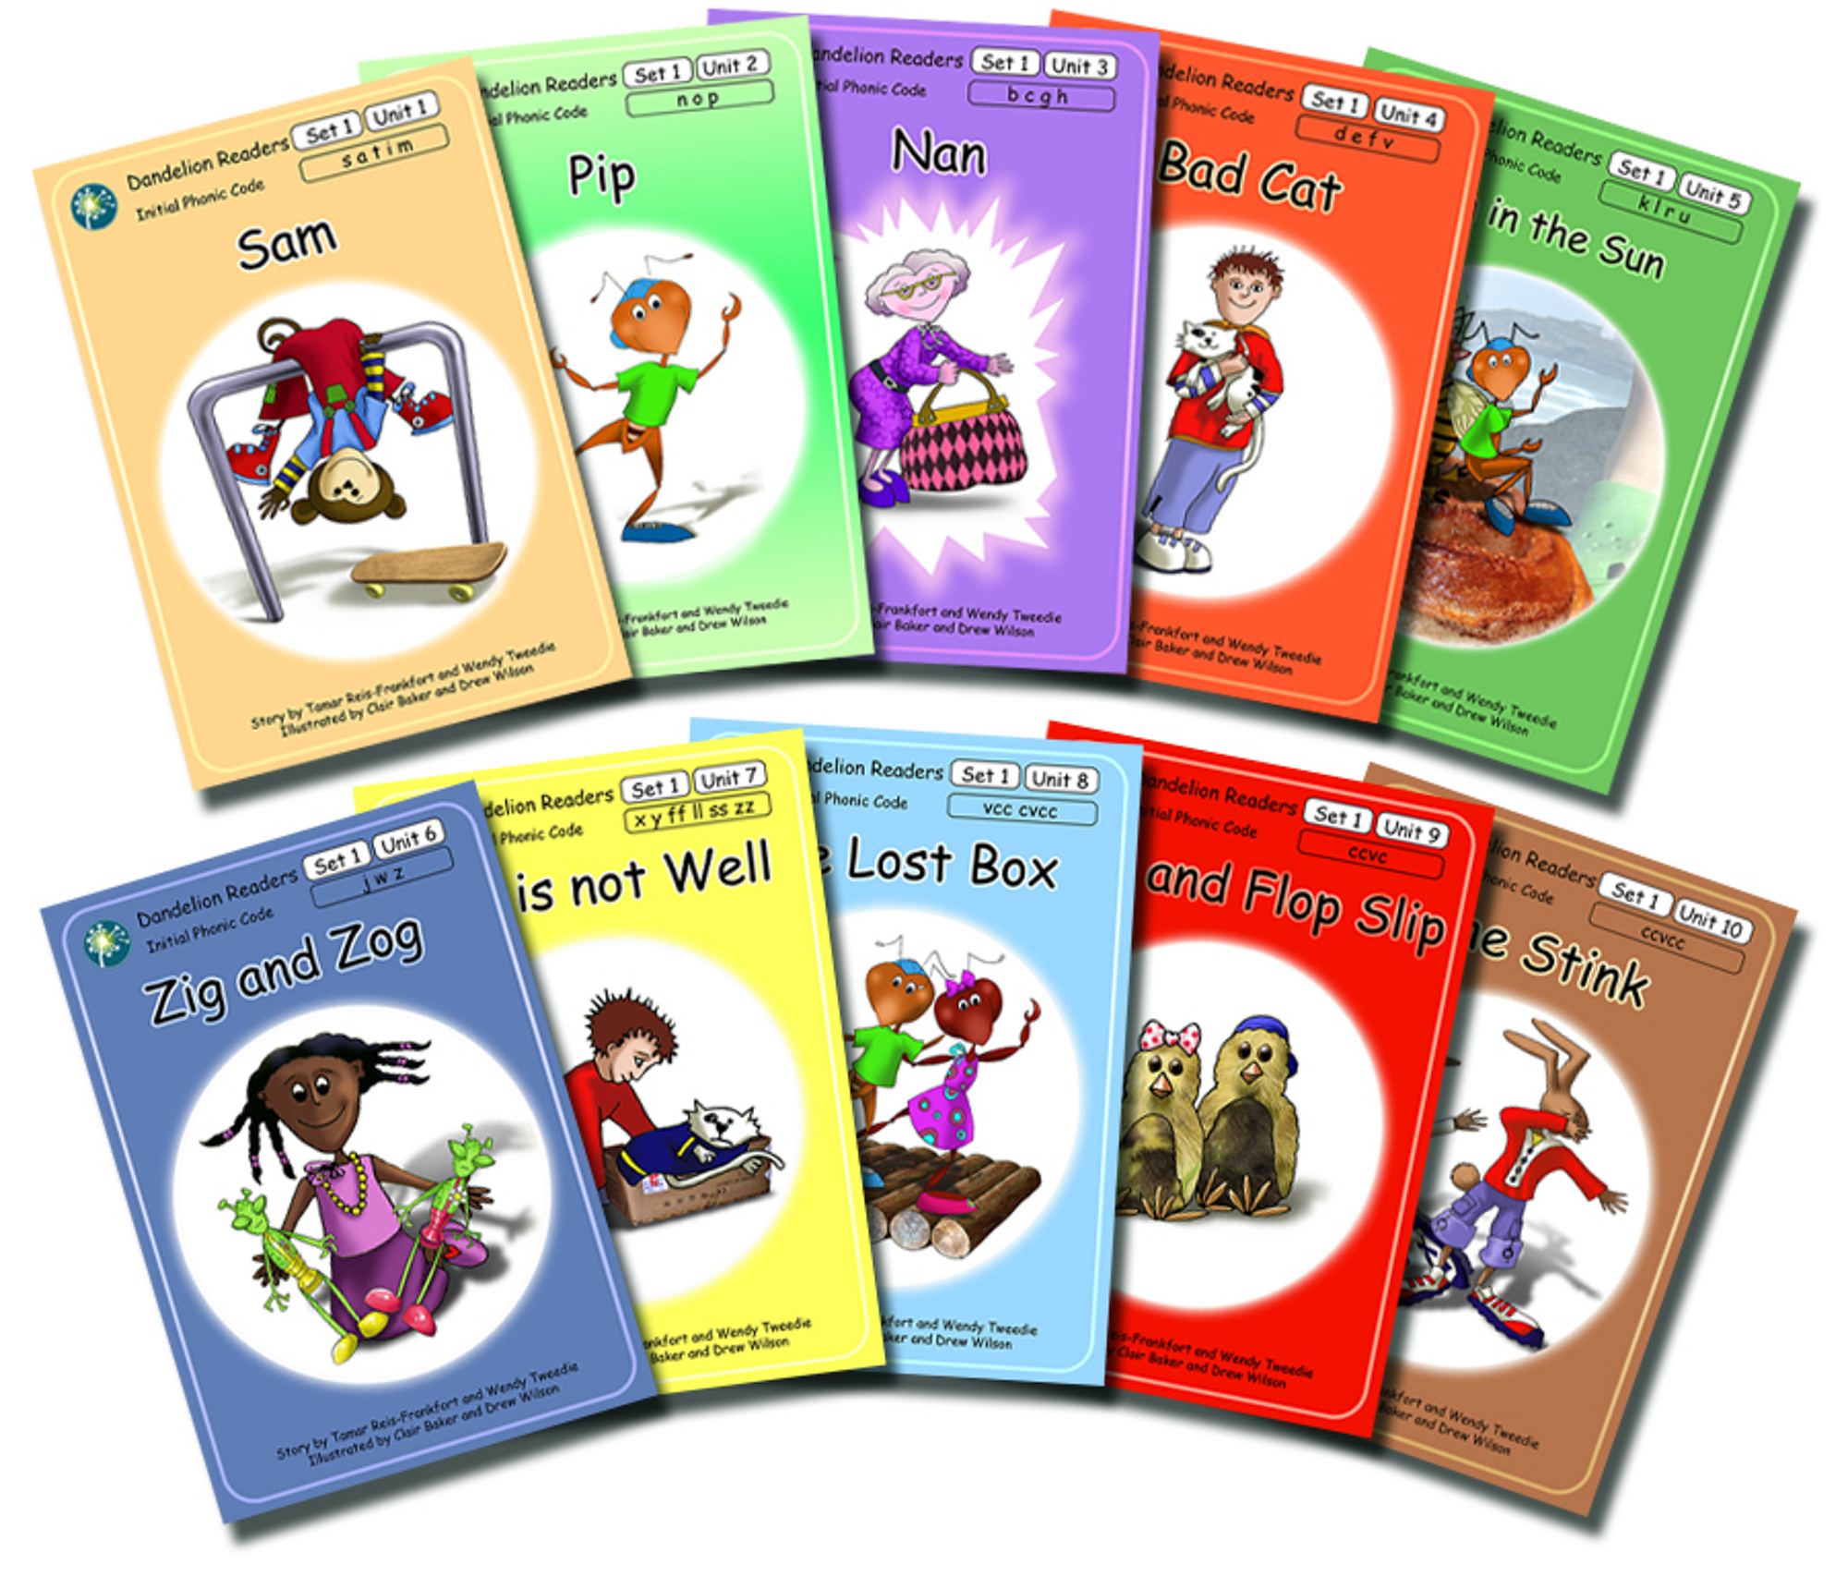
Reading at st catherines…
The books children bring home are closely matched to their phonics phase and ability.
Reception children bring home 2 books a week to share at home.
Year 1 have the opportunity to bring home 2 books twice a week.
Please sign/ comment in reading records so we know you have shared the book at home.
The books children bring home are intended to be read for pleasure and the books we read at school are harder so reading skills can be taught by staff.

Slide 22
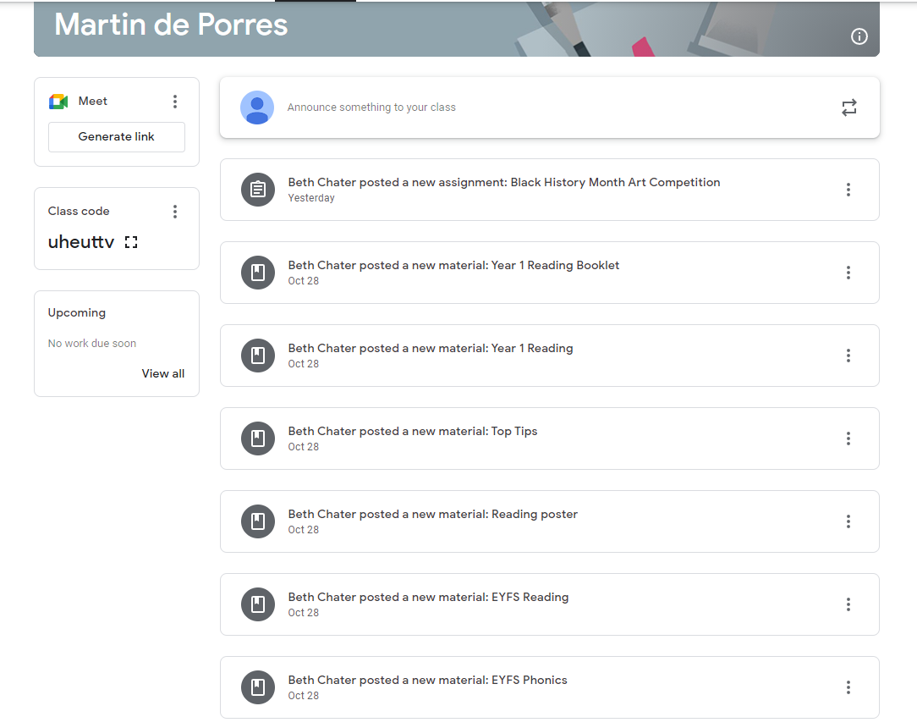
Helping at home…

Slide 23
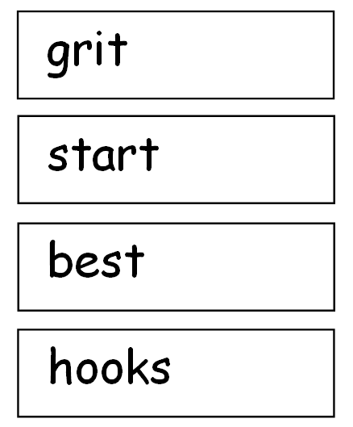
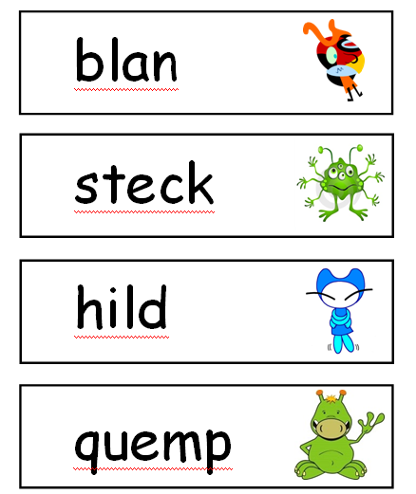
Year 1 Phonics Test

